Slide 1
Latest update
2024-04-23

Slide 2
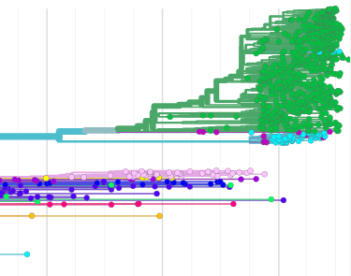
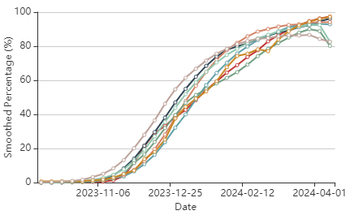
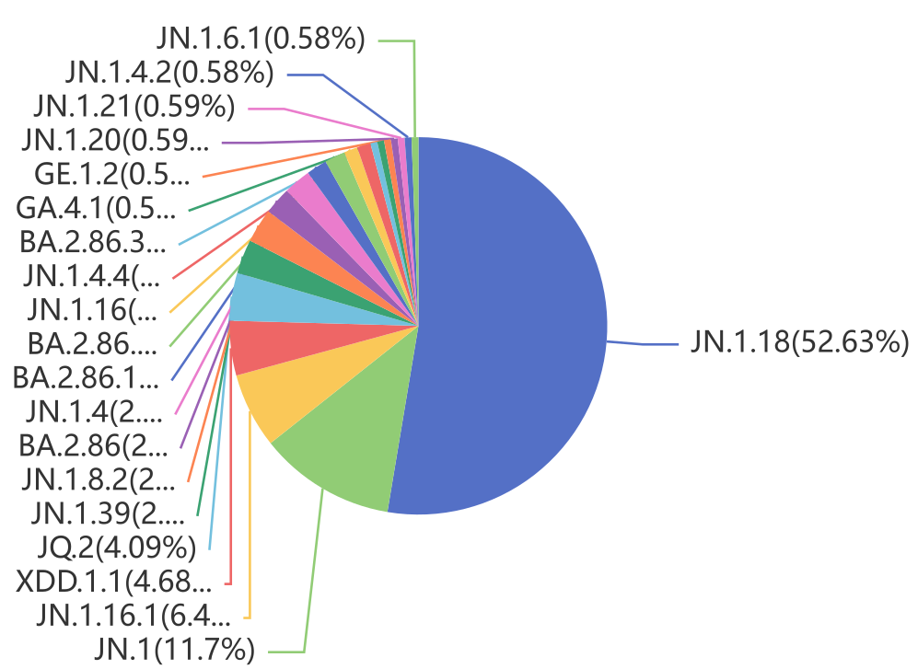
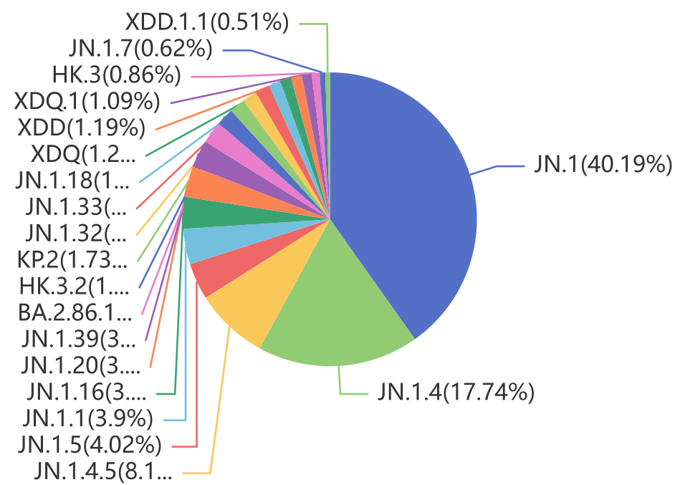
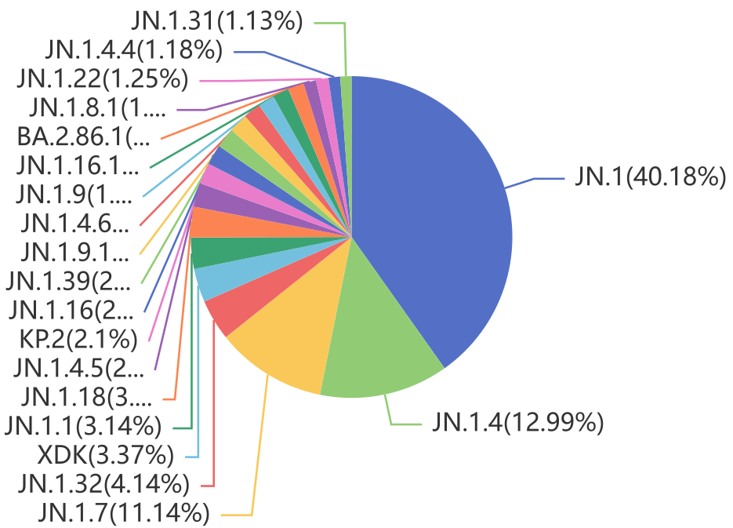
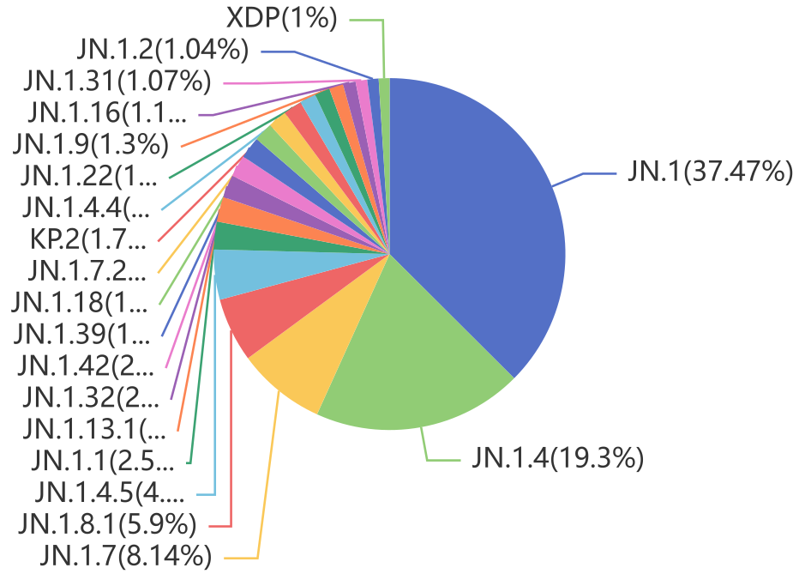
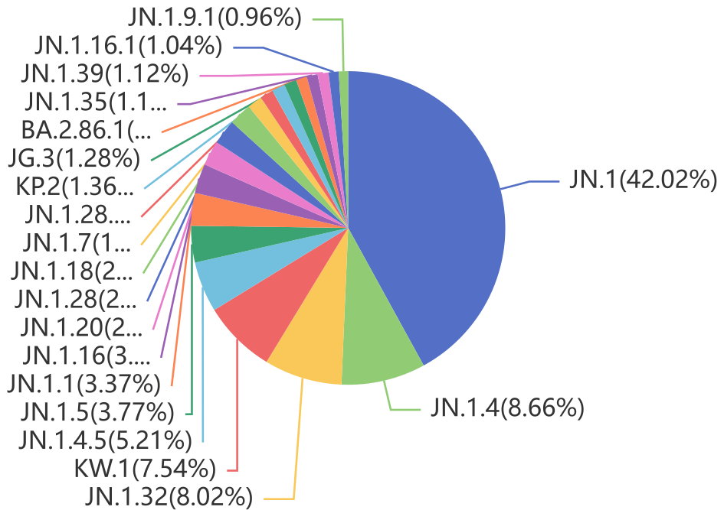
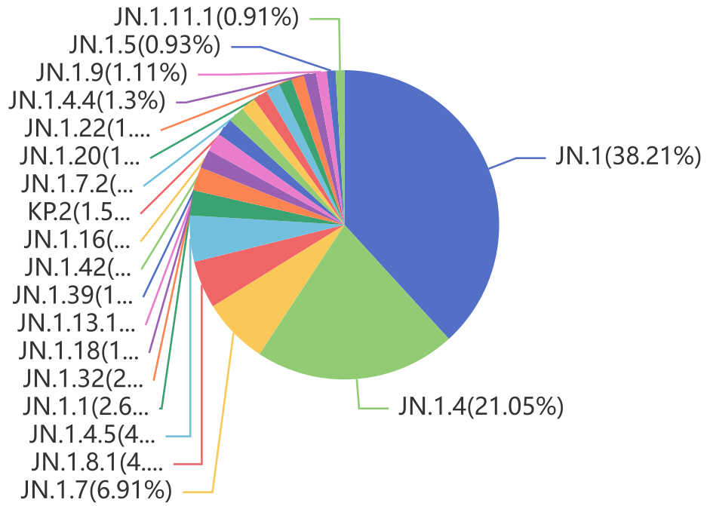
Emerging variant analysis 2024-04-16
EpiCoV™ Update
JN.1 sub-lineages continue to rise. As of 16 April 2024, 126 countries shared 175,189 are JN.1+JN.1.*. The phylogenetic relationship of the currently largest circulating sublineages is shown in the tree below and the VOI is also tracked at: https://gisaid.org/hcov19-variants/.
VOI JN.1* versus XBB1.5 vaccine strain spike substitutions
ACE2
KP*
KS.1
XDK.1
KR.1
KU.1, KW.1
JN.1+JN.1*
KV.1
XDQ.1
EG.5*
XBB.1.16*, XBB.1.9*
XBB.1.5*
XBB.1.5* family
XBB.2.3*
Recently approved updated vaccines use XBB.1.5 strains as basis. The majority of current strains in circulation globally belong to
the JN.1* family.
Omicron
2023-Jun
2023-Oct
2024-Feb
SARS-CoV-2 spike glycoprotein trimer (3 units shown, gray ribbons) in complex with human host cell receptor ACE2 (1 unit shown).
Africa
Asia
Europe
North America
Oceania
South America
Lineage distribution 16 Feb 2024 – 16 Apr 2024 (by collection date)
by BII/GIS, A*STAR Singapore

Slide 3
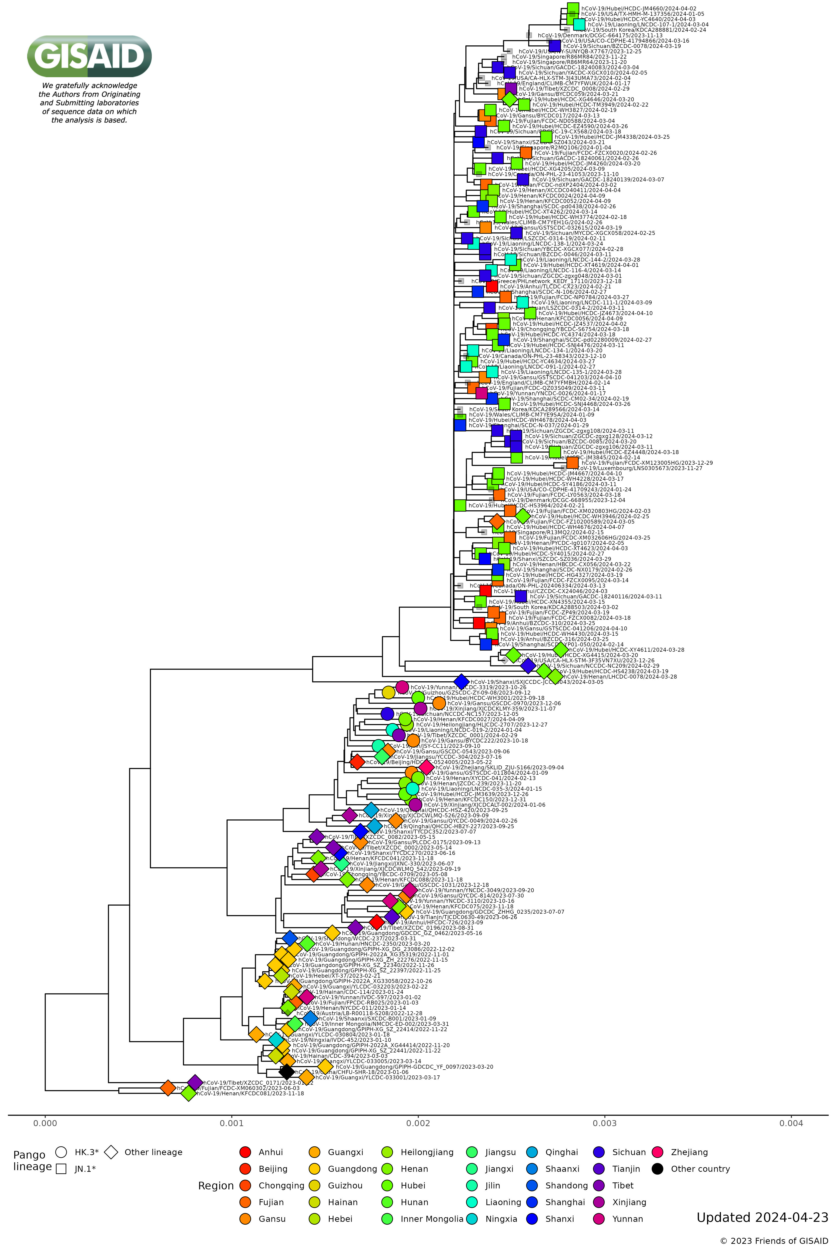
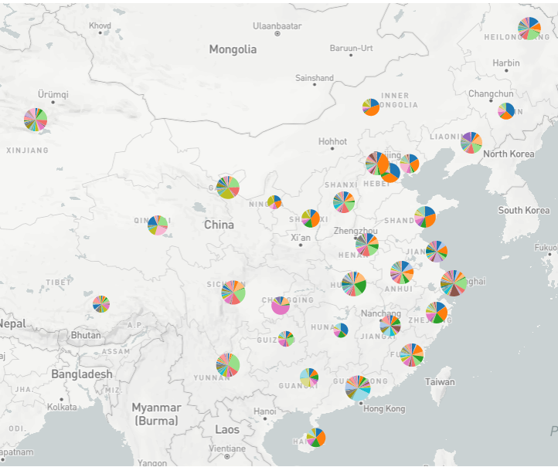
Representative phylogenetics
of recent genome sequences from 30 regions across China
(in global context)
2024-04-23
EpiCoV™ Update
We gratefully acknowledge the Authors from Originating and Submitting laboratories of sequence data on which the analysis is based.
Updated 2024-04-23
by FIOCRUZ, Brazil

Slide 4
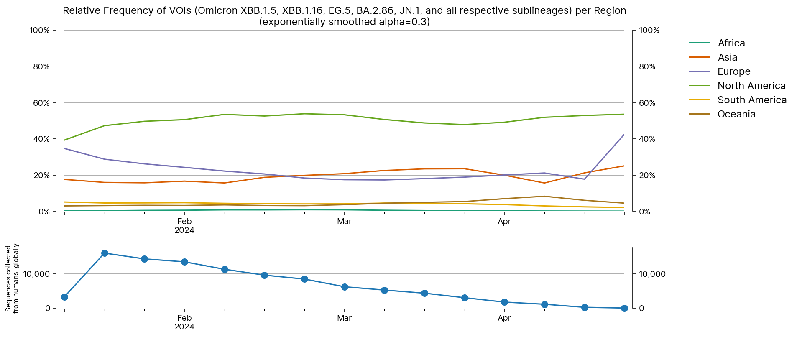
Global Occurrence and Frequencies of VOIs
(Omicron XBB.1.5, XBB.1.16, EG.5, BA.2.86, JN.1 and all respective sublineages)
2024-04-23
We gratefully acknowledge the Authors from Originating and Submitting laboratories of sequence data on which the analysis is based.
by BII/GIS, A*STAR Singapore

Slide 5
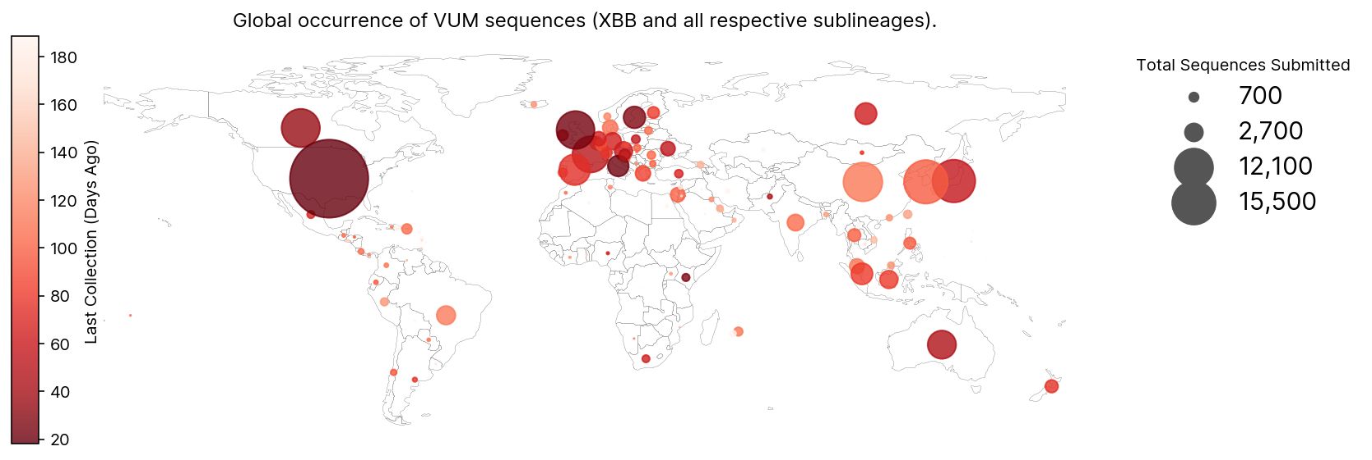
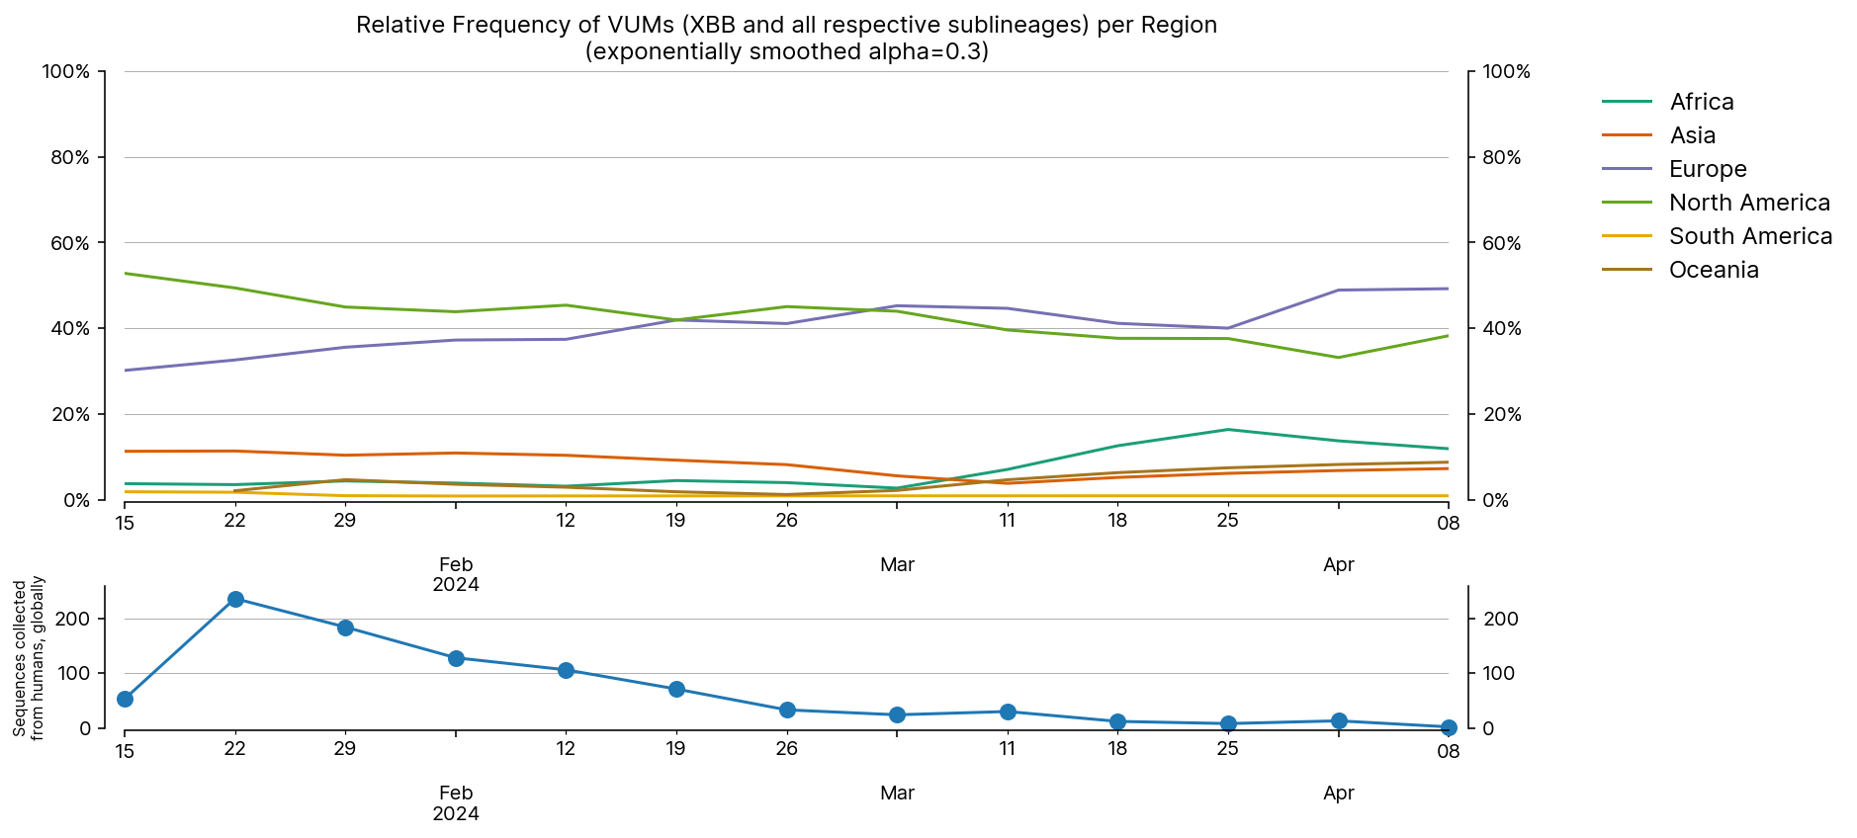
Global Occurrence and Frequencies of VUMs
(Omicron XBB and all respective sublineages that are not VOIs)
2024-04-23
We gratefully acknowledge the Authors from Originating and Submitting laboratories of sequence data on which the analysis is based.
by BII/GIS, A*STAR Singapore

Slide 6
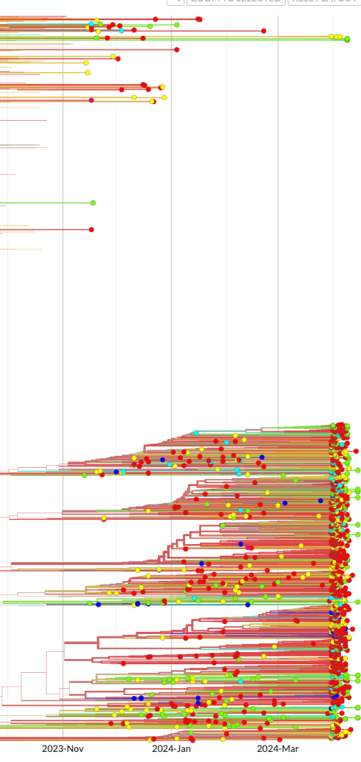
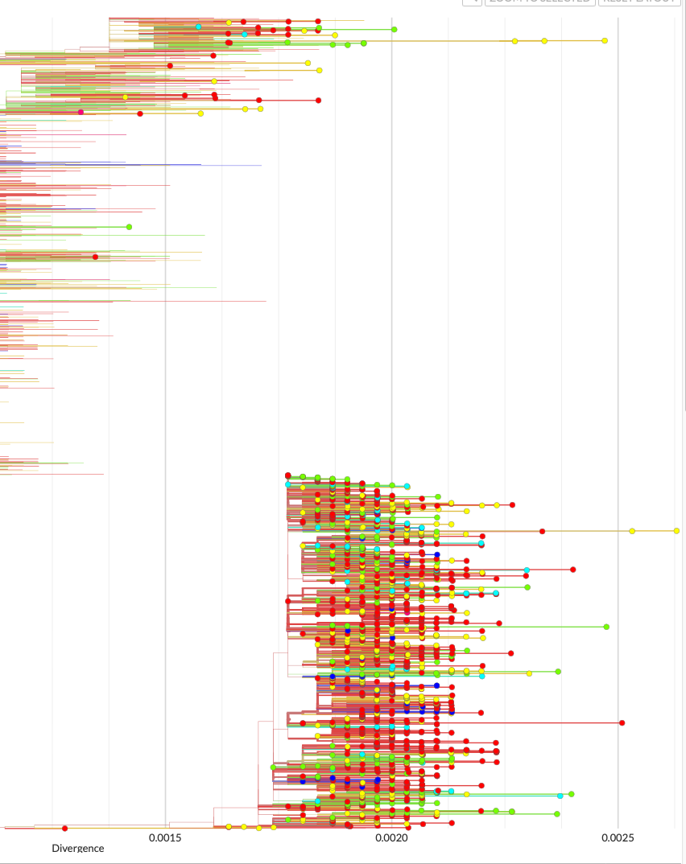
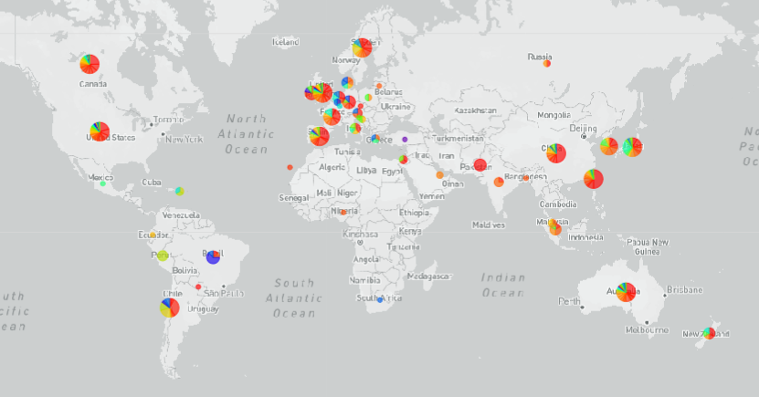
Phylodynamics of Variants of Interest and Variants under Monitoring
2024-04-23
Showing 2,974 genomes collected between Nov 2023 and April 2024
Time-resolved tree
Genetic divergence tree
We gratefully acknowledge the Authors from Originating and Submitting laboratories of sequence data on which the analysis is based.
Geography
by FIOCRUZ, Brazil

Slide 7
Emerging variant analysis 2024-04-23
Emerging Variants by Spread
Clade/Lineage
Count^
Cumulative
locations
North
America
South
America
geoMap
Constellation*
Europe
Africa
Asia
Oceania
GRA (KP.2)
601
N_P13L, N_Q229K, Spike_A570V, Spike_D405N, Spike_D614G, Spike_D796Y, Spike_E484K, Spike_F456L, Spike_F486P, Spike_G142D, Spike_G339H, Spike_G446S, Spike_H245N, Spike_H655Y, Spike_H69del, Spike_I332V, Spike_K356T, Spike_K417N, Spike_L452W, Spike_L455S, Spike_N440K, Spike_N450D, Spike_N460K, Spike_N481K, Spike_N501Y, Spike_P681R, Spike_Q498R, Spike_R158G, Spike_R346T, Spike_R403K, Spike_R408S, Spike_S371F, Spike_S373P, Spike_S375F, Spike_S477N, Spike_S939F, Spike_T376A, Spike_T478K, Spike_V445H, Spike_V483del, Spike_V70del,
Spike_Y144del, Spike_Y505H
% prevalence
GRA (KP.3)
147
N_P13L, N_Q229K, Spike_A570V, Spike_D405N, Spike_D614G, Spike_D796Y, Spike_E484K, Spike_F456L, Spike_F486P, Spike_G142D, Spike_G339H, Spike_G446S, Spike_H245N, Spike_H655Y, Spike_H69del, Spike_I332V, Spike_K356T, Spike_K417N, Spike_L452W, Spike_L455S, Spike_N440K, Spike_N450D, Spike_N460K, Spike_N481K, Spike_N501Y, Spike_P681R, Spike_Q493E, Spike_Q498R, Spike_R158G, Spike_R403K, Spike_R408S, Spike_S371F, Spike_S373P, Spike_S375F, Spike_S477N, Spike_S939F, Spike_T376A, Spike_T478K, Spike_V445H, Spike_V483del, Spike_V70del, Spike_Y144del, Spike_Y505H
% prevalence
^Count in past 100 days from analysis date
*Constellation of aa changes shown in literature to have phenotypic effects such as antibody escape, ACE2 binding, changes in Spike protein expression and stability, as curated by CoVsurver. Constellations in Emerging Variants by Spread are ranked by gainInNumNewLocationsInPast30days x sumOfWeightedaaChanges. AA change in the constellation that differs from other common changes seen in the lineage are highlighted in orange.
by BII/GIS, A*STAR Singapore

Slide 8
Emerging variant analysis 2024-04-23
Emerging Variants by Spread
Clade/Lineage
Count^
Cumulative
locations
North
America
South
America
geoMap
Constellation*
Europe
Africa
Asia
Oceania
GRA (JN.1)
609
N_P13L, N_Q229K, Spike_A570V, Spike_D405N, Spike_D614G, Spike_D796Y, Spike_E484K, Spike_F486P, Spike_G142D, Spike_G339H, Spike_G446S, Spike_H245N, Spike_H655Y, Spike_H69del, Spike_I332V, Spike_K356T, Spike_K417N, Spike_L452W, Spike_L455S, Spike_N440K, Spike_N450D, Spike_N460K, Spike_N481K, Spike_N501Y, Spike_P681R, Spike_Q498R, Spike_R158G, Spike_R403K, Spike_S371F, Spike_S373P, Spike_S375F, Spike_S477N, Spike_S939F, Spike_T376A, Spike_T478K, Spike_V445H, Spike_V483del, Spike_V70del, Spike_Y144del, Spike_Y505H
% prevalence
GRA (JN.1.16)
1,065
N_P13L, N_Q229K, Spike_A570V, Spike_D405N, Spike_D614G, Spike_D796Y, Spike_E484K, Spike_F456L, Spike_F486P, Spike_G142D, Spike_G339H, Spike_G446S, Spike_H245N, Spike_H655Y, Spike_H69del, Spike_I332V, Spike_K356T, Spike_K417N, Spike_L452W, Spike_L455S, Spike_N440K, Spike_N450D, Spike_N460K, Spike_N481K, Spike_N501Y, Spike_P681R, Spike_Q498R, Spike_R158G, Spike_R403K, Spike_R408S, Spike_S371F, Spike_S373P, Spike_S375F, Spike_S477N, Spike_S939F, Spike_T376A, Spike_T478K, Spike_V445H, Spike_V483del, Spike_V70del, Spike_Y144del, Spike_Y505H
% prevalence
^Count in past 100 days from analysis date
*Constellation of aa changes shown in literature to have phenotypic effects such as antibody escape, ACE2 binding, changes in Spike protein expression and stability, as curated by CoVsurver. Constellations in Emerging Variants by Spread are ranked by gainInNumNewLocationsInPast30days x sumOfWeightedaaChanges. AA change in the constellation that differs from other common changes seen in the lineage are highlighted in orange.
by BII/GIS, A*STAR Singapore

Slide 9
Emerging variant analysis 2024-04-23
Emerging Variants by Spread
Clade/Lineage
Count^
Cumulative
locations
North
America
South
America
geoMap
Constellation*
Europe
Africa
Asia
Oceania
GRA (JN.1.18)
1,792
N_P13L, N_Q229K, Spike_A570V, Spike_D405N, Spike_D614G, Spike_D796Y, Spike_E484K, Spike_F486P, Spike_G142D, Spike_G339H, Spike_G446S, Spike_H245N, Spike_H655Y, Spike_H69del, Spike_I332V, Spike_K356T, Spike_K417N, Spike_L452W, Spike_L455S, Spike_N440K, Spike_N450D, Spike_N460K, Spike_N481K, Spike_N501Y, Spike_P681R, Spike_Q498R, Spike_R158G, Spike_R346T, Spike_R403K, Spike_R408S, Spike_S371F, Spike_S373P, Spike_S375F, Spike_S477N, Spike_S939F, Spike_T376A, Spike_T478K, Spike_V445H, Spike_V483del, Spike_V70del, Spike_Y144del, Spike_Y505H
% prevalence
GRA (XDK.1)
4
N_P13L, N_Q229K, N_T135I, Spike_A570V, Spike_D405N, Spike_D614G, Spike_D796Y, Spike_E484K, Spike_F486P, Spike_G142D, Spike_G339H, Spike_G446S, Spike_H245N, Spike_H655Y, Spike_H69del, Spike_I332V, Spike_K356T, Spike_K417N, Spike_L452W, Spike_L455S, Spike_N440K, Spike_N450D, Spike_N460K, Spike_N481K, Spike_N501Y, Spike_P681R, Spike_Q498R, Spike_R158G, Spike_R346T, Spike_R403K, Spike_R408S, Spike_S371F, Spike_S373P, Spike_S375F, Spike_S477N, Spike_S939F, Spike_T376A, Spike_T478K, Spike_V445H, Spike_V483del, Spike_V70del, Spike_Y144del, Spike_Y505H
% prevalence
^Count in past 100 days from analysis date
*Constellation of aa changes shown in literature to have phenotypic effects such as antibody escape, ACE2 binding, changes in Spike protein expression and stability, as curated by CoVsurver. Constellations in Emerging Variants by Spread are ranked by gainInNumNewLocationsInPast30days x sumOfWeightedaaChanges. AA change in the constellation that differs from other common changes seen in the lineage are highlighted in orange.
by BII/GIS, A*STAR Singapore

Slide 10
Emerging variant analysis 2024-04-23
Emerging Variants by Spread
Clade/Lineage
Count^
Cumulative
locations
North
America
South
America
geoMap
Constellation*
Europe
Africa
Asia
Oceania
GRA (JN.1.16)
59
M_L46F, N_P13L, N_Q229K, Spike_A570V, Spike_D405N, Spike_D614G, Spike_D796Y, Spike_E484K, Spike_F456L, Spike_F486P, Spike_G142D, Spike_G339H, Spike_G446S, Spike_H245N, Spike_H655Y, Spike_H69del, Spike_I332V, Spike_K356T, Spike_K417N, Spike_L452W, Spike_L455S, Spike_N440K, Spike_N450D, Spike_N460K, Spike_N481K, Spike_N501Y, Spike_P681R, Spike_Q498R, Spike_R158G, Spike_R403K, Spike_R408S, Spike_S371F, Spike_S373P, Spike_S375F, Spike_S477N, Spike_S939F, Spike_T376A, Spike_T478K, Spike_V445H, Spike_V483del, Spike_V70del, Spike_Y144del, Spike_Y505H
% prevalence
GRA (JN.1)
143
NS3_N119Y, N_P13L, N_Q229K, Spike_A570V, Spike_D405N, Spike_D614G, Spike_D796Y, Spike_E484K, Spike_F486P, Spike_G142D, Spike_G339H, Spike_G446S, Spike_H245N, Spike_H655Y, Spike_H69del, Spike_I332V, Spike_K356T, Spike_K417N, Spike_L452W, Spike_L455S, Spike_N440K, Spike_N450D, Spike_N460K, Spike_N481K, Spike_N501Y, Spike_P681R, Spike_Q498R, Spike_R158G, Spike_R403K, Spike_R408S, Spike_S371F, Spike_S373P, Spike_S375F, Spike_S477N, Spike_S939F, Spike_T376A, Spike_T478K, Spike_V445H, Spike_V483del, Spike_V70del, Spike_Y144del, Spike_Y505H
% prevalence
^Count in past 100 days from analysis date
*Constellation of aa changes shown in literature to have phenotypic effects such as antibody escape, ACE2 binding, changes in Spike protein expression and stability, as curated by CoVsurver. Constellations in Emerging Variants by Spread are ranked by gainInNumNewLocationsInPast30days x sumOfWeightedaaChanges. AA change in the constellation that differs from other common changes seen in the lineage are highlighted in orange.
by BII/GIS, A*STAR Singapore

Slide 11
Emerging variant analysis 2024-04-23
Emerging Variants by Spread
Clade/Lineage
Count^
Cumulative
locations
North
America
South
America
geoMap
Constellation*
Europe
Africa
Asia
Oceania
GRA (JN.1.16.1)
8
N_P13L, N_Q229K, Spike_A570V, Spike_D405N, Spike_D614G, Spike_D796Y, Spike_E484K, Spike_F456L, Spike_F486P, Spike_G142D, Spike_G339H, Spike_G446S, Spike_H245N, Spike_H655Y, Spike_H69F, Spike_I332V, Spike_K356T, Spike_K417N, Spike_L452W, Spike_L455S, Spike_N440K, Spike_N450D, Spike_N460K, Spike_N481K, Spike_N501Y, Spike_P681R, Spike_Q498R, Spike_R158G, Spike_R346T, Spike_R403K, Spike_R408S, Spike_S371F, Spike_S373P, Spike_S375F, Spike_S477N, Spike_S939F, Spike_T376A, Spike_T478K, Spike_V445H, Spike_V483del, Spike_V70del, Spike_Y144del, Spike_Y505H
% prevalence
GRA (KP.2)
5
N_P13L, N_Q229K, Spike_A570V, Spike_D405N, Spike_D614G, Spike_D796Y, Spike_E484K, Spike_F456L, Spike_F486P, Spike_G142D, Spike_G339H, Spike_G446S, Spike_H146del, Spike_H245N, Spike_H655Y, Spike_H69del, Spike_I332V, Spike_K356T, Spike_K417N, Spike_L452W, Spike_L455S, Spike_N440K, Spike_N450D, Spike_N460K, Spike_N481K, Spike_N501Y, Spike_P681R, Spike_Q498R, Spike_R158G, Spike_R346T, Spike_R403K, Spike_R408S, Spike_S371F, Spike_S373P, Spike_S375F, Spike_S477N, Spike_S939F, Spike_T376A, Spike_T478K, Spike_V445H, Spike_V483del, Spike_V70del, Spike_Y505H
% prevalence
^Count in past 100 days from analysis date
*Constellation of aa changes shown in literature to have phenotypic effects such as antibody escape, ACE2 binding, changes in Spike protein expression and stability, as curated by CoVsurver. Constellations in Emerging Variants by Spread are ranked by gainInNumNewLocationsInPast30days x sumOfWeightedaaChanges. AA change in the constellation that differs from other common changes seen in the lineage are highlighted in orange.
by BII/GIS, A*STAR Singapore

Slide 12
Emerging variant analysis 2024-04-23
Emerging Variants by Spread
Clade/Lineage
Count^
Cumulative
locations
North
America
South
America
geoMap
Constellation*
Europe
Africa
Asia
Oceania
GRA (JN.1)
72
N_P13L, N_Q229K, Spike_A570V, Spike_D405N, Spike_D614G, Spike_D796Y, Spike_E484K, Spike_F486P, Spike_G142D, Spike_G339H, Spike_G446S, Spike_H245N, Spike_H655Y, Spike_H69del, Spike_I332V, Spike_K356T, Spike_K417N, Spike_L452W, Spike_L455S, Spike_N440K, Spike_N450D, Spike_N460K, Spike_N481K, Spike_N501Y, Spike_P681R, Spike_Q498R, Spike_R158G, Spike_R403K, Spike_R408S, Spike_R683W, Spike_S371F, Spike_S373P, Spike_S375F, Spike_S477N, Spike_S939F, Spike_T376A, Spike_T478K, Spike_V445H, Spike_V483del, Spike_V70del, Spike_Y144del, Spike_Y505H
% prevalence
GRA (JN.1)
282
N_P13L, N_Q229K, Spike_A570V, Spike_D405N, Spike_D614G, Spike_D796Y, Spike_E484K, Spike_F486P, Spike_G142D, Spike_G339H, Spike_G446S, Spike_H245N, Spike_H655Y, Spike_H69del, Spike_I332V, Spike_K356T, Spike_K417N, Spike_L452W, Spike_L455S, Spike_L5F, Spike_N440K, Spike_N450D, Spike_N460K, Spike_N481K, Spike_N501Y, Spike_P681R, Spike_Q498R, Spike_R158G, Spike_R403K, Spike_R408S, Spike_S371F, Spike_S373P, Spike_S375F, Spike_S477N, Spike_S939F, Spike_T376A, Spike_T478K, Spike_V445H, Spike_V483del, Spike_V70del, Spike_Y144del, Spike_Y505H
% prevalence
^Count in past 100 days from analysis date
*Constellation of aa changes shown in literature to have phenotypic effects such as antibody escape, ACE2 binding, changes in Spike protein expression and stability, as curated by CoVsurver. Constellations in Emerging Variants by Spread are ranked by gainInNumNewLocationsInPast30days x sumOfWeightedaaChanges. AA change in the constellation that differs from other common changes seen in the lineage are highlighted in orange.
by BII/GIS, A*STAR Singapore

Slide 13
Emerging variant analysis 2024-04-23
Emerging Variants by Spread
Clade/Lineage
Count^
Cumulative
locations
North
America
South
America
geoMap
Constellation*
Europe
Africa
Asia
Oceania
GRA (XDQ.1)
142
E_T11A, N_P13L, Spike_A475V, Spike_A570V, Spike_D405N, Spike_D614G, Spike_D796Y, Spike_E484K, Spike_F486P, Spike_G142D, Spike_G339H, Spike_G446S, Spike_H245N, Spike_H655Y, Spike_H69del, Spike_I332V, Spike_K356T, Spike_K417N, Spike_L452W, Spike_N440K, Spike_N450D, Spike_N460K, Spike_N481K, Spike_N501Y, Spike_P681R, Spike_Q498R, Spike_R158G, Spike_R403K, Spike_R408S, Spike_S371F, Spike_S373P, Spike_S375F, Spike_S477N, Spike_T376A, Spike_T478K, Spike_V445H, Spike_V483del, Spike_V70del, Spike_Y144del, Spike_Y505H
% prevalence
GRA (JN.1.16.1)
5
N_P13L, N_Q229K, Spike_A570V, Spike_D405N, Spike_D614G, Spike_D796Y, Spike_E484K, Spike_F456L, Spike_F486P, Spike_G142D, Spike_G339H, Spike_G446S, Spike_H245N, Spike_H655Y, Spike_H69del, Spike_I332V, Spike_K356T, Spike_K417N, Spike_L452W, Spike_L455S, Spike_N440K, Spike_N450D, Spike_N460K, Spike_N481K, Spike_N501Y, Spike_P1263L, Spike_P681R, Spike_Q498R, Spike_R158G, Spike_R346T, Spike_R403K, Spike_R408S, Spike_S371F, Spike_S373P, Spike_S375F, Spike_S477N, Spike_S939F, Spike_T376A, Spike_T478K, Spike_V445H, Spike_V483del, Spike_V70del, Spike_Y144del, Spike_Y505H
% prevalence
^Count in past 100 days from analysis date
*Constellation of aa changes shown in literature to have phenotypic effects such as antibody escape, ACE2 binding, changes in Spike protein expression and stability, as curated by CoVsurver. Constellations in Emerging Variants by Spread are ranked by gainInNumNewLocationsInPast30days x sumOfWeightedaaChanges. AA change in the constellation that differs from other common changes seen in the lineage are highlighted in orange.
by BII/GIS, A*STAR Singapore

Slide 14
Emerging variant analysis 2024-04-23
Emerging Variants by Spread
Clade/Lineage
Count^
Cumulative
locations
North
America
South
America
geoMap
Constellation*
Europe
Africa
Asia
Oceania
GRA (JN.1.16.1)
2
N_P13L, N_Q229K, Spike_A570V, Spike_D405N, Spike_D614G, Spike_D796Y, Spike_E484K, Spike_F456L, Spike_F486P, Spike_G142D, Spike_G339H, Spike_G446S, Spike_H245N, Spike_H655Y, Spike_H69del, Spike_I332V, Spike_K356T, Spike_K417N, Spike_L452W, Spike_L455S, Spike_N440K, Spike_N450D, Spike_N460K, Spike_N481K, Spike_N501Y, Spike_P681R, Spike_Q498R, Spike_R158G, Spike_R346T, Spike_R403K, Spike_R408S, Spike_S255F, Spike_S371F, Spike_S373P, Spike_S375F, Spike_S477N, Spike_S939F, Spike_T376A, Spike_T478K, Spike_V445H, Spike_V483del, Spike_V70del, Spike_Y144del, Spike_Y505H
% prevalence
GRA (JN.1.39)
13
NS3_V80A, N_P13L, N_Q229K, Spike_A570V, Spike_D405N, Spike_D614G, Spike_D796Y, Spike_E484K, Spike_F456L, Spike_F486P, Spike_G142D, Spike_G339H, Spike_G446S, Spike_H245N, Spike_H655Y, Spike_H69del, Spike_I332V, Spike_K356T, Spike_K417N, Spike_L452W, Spike_L455S, Spike_N440K, Spike_N450D, Spike_N460K, Spike_N481K, Spike_N501Y, Spike_P681R, Spike_Q498R, Spike_R158G, Spike_R346T, Spike_R403K, Spike_R408S, Spike_S371F, Spike_S373P, Spike_S375F, Spike_S477N, Spike_S939F, Spike_T376A, Spike_T478K, Spike_V445H, Spike_V483del, Spike_V70del, Spike_Y144del, Spike_Y505H
% prevalence
^Count in past 100 days from analysis date
*Constellation of aa changes shown in literature to have phenotypic effects such as antibody escape, ACE2 binding, changes in Spike protein expression and stability, as curated by CoVsurver. Constellations in Emerging Variants by Spread are ranked by gainInNumNewLocationsInPast30days x sumOfWeightedaaChanges. AA change in the constellation that differs from other common changes seen in the lineage are highlighted in orange.
by BII/GIS, A*STAR Singapore

Slide 15
Emerging variant analysis 2024-04-23
Emerging Variants by Spread
Clade/Lineage
Count^
Cumulative
locations
North
America
South
America
geoMap
Constellation*
Europe
Africa
Asia
Oceania
GRA (KP.3)
2
NS3_L73F, N_P13L, N_Q229K, Spike_A570V, Spike_D405N, Spike_D614G, Spike_D796Y, Spike_E484K, Spike_F456L, Spike_F486P, Spike_G142D, Spike_G339H, Spike_G446S, Spike_H245N, Spike_H655Y, Spike_H69del, Spike_I332V, Spike_K356T, Spike_K417N, Spike_L452W, Spike_L455S, Spike_N440K, Spike_N450D, Spike_N460K, Spike_N481K, Spike_N501Y, Spike_P681R, Spike_Q493E, Spike_Q498R, Spike_R158G, Spike_R403K, Spike_R408S, Spike_S371F, Spike_S373P, Spike_S375F, Spike_S477N, Spike_S939F, Spike_T376A, Spike_T478K, Spike_V445H, Spike_V483del, Spike_V70del, Spike_Y144del, Spike_Y505H
% prevalence
GRA (JN.1.23)
3
N_P13L, N_Q229K, Spike_A570V, Spike_D405N, Spike_D614G, Spike_D796Y, Spike_E484K, Spike_F486P, Spike_G142D, Spike_G339H, Spike_G446S, Spike_H245N, Spike_H655Y, Spike_H69del, Spike_I332V, Spike_K356T, Spike_K417N, Spike_K444R, Spike_L452W, Spike_L455S, Spike_N137K, Spike_N440K, Spike_N450D, Spike_N460K, Spike_N481K, Spike_N501Y, Spike_P681R, Spike_Q498R, Spike_R158G, Spike_R403K, Spike_R408S, Spike_S371F, Spike_S373P, Spike_S375F, Spike_S477N, Spike_S939F, Spike_T376A, Spike_T478K, Spike_V445H, Spike_V483del, Spike_V70del, Spike_Y144del, Spike_Y453F, Spike_Y505H
% prevalence
^Count in past 100 days from analysis date
*Constellation of aa changes shown in literature to have phenotypic effects such as antibody escape, ACE2 binding, changes in Spike protein expression and stability, as curated by CoVsurver. Constellations in Emerging Variants by Spread are ranked by gainInNumNewLocationsInPast30days x sumOfWeightedaaChanges. AA change in the constellation that differs from other common changes seen in the lineage are highlighted in orange.
by BII/GIS, A*STAR Singapore

Slide 16
Emerging variant analysis 2024-04-23
Emerging Variants by Spread
Clade/Lineage
Count^
Cumulative
locations
North
America
South
America
geoMap
Constellation*
Europe
Africa
Asia
Oceania
GRA (KP.1.1)
4
N_P13L, N_Q229K, Spike_A570V, Spike_D405N, Spike_D614G, Spike_D796Y, Spike_E484K, Spike_F456L, Spike_F486P, Spike_G142D, Spike_G339H, Spike_G446S, Spike_H245N, Spike_H655Y, Spike_H69del, Spike_I332V, Spike_K356T, Spike_K417N, Spike_L452W, Spike_L455S, Spike_L5F, Spike_N440K, Spike_N450D, Spike_N460K, Spike_N481K, Spike_N501Y, Spike_P681R, Spike_Q498R, Spike_R158G, Spike_R346T, Spike_R403K, Spike_R408S, Spike_S371F, Spike_S373P, Spike_S375F, Spike_S477N, Spike_S939F, Spike_T376A, Spike_T478K, Spike_V445H, Spike_V483del, Spike_V70del, Spike_Y144del, Spike_Y505H
% prevalence
GRA (KP.2)
2
N_P13L, N_Q229K, N_R68P, Spike_A570V, Spike_D405N, Spike_D614G, Spike_D796Y, Spike_E484K, Spike_F456L, Spike_F486P, Spike_G142D, Spike_G339H, Spike_G446S, Spike_H245N, Spike_H655Y, Spike_H69del, Spike_I332V, Spike_K356T, Spike_K417N, Spike_L452W, Spike_L455S, Spike_N440K, Spike_N450D, Spike_N460K, Spike_N481K, Spike_N501Y, Spike_P681R, Spike_Q498R, Spike_R158G, Spike_R346T, Spike_R403K, Spike_R408S, Spike_S371F, Spike_S373P, Spike_S375F, Spike_S477N, Spike_S939F, Spike_T376A, Spike_T478K, Spike_V445H, Spike_V483del, Spike_V70del, Spike_Y144del, Spike_Y505H
% prevalence
^Count in past 100 days from analysis date
*Constellation of aa changes shown in literature to have phenotypic effects such as antibody escape, ACE2 binding, changes in Spike protein expression and stability, as curated by CoVsurver. Constellations in Emerging Variants by Spread are ranked by gainInNumNewLocationsInPast30days x sumOfWeightedaaChanges. AA change in the constellation that differs from other common changes seen in the lineage are highlighted in orange.
by BII/GIS, A*STAR Singapore

Slide 17
Emerging variant analysis 2024-04-23
Emerging Variants by Spread
Clade/Lineage
Count^
Cumulative
locations
North
America
South
America
geoMap
Constellation*
Europe
Africa
Asia
Oceania
GRA (KP.2)
3
N_P13L, N_Q229K, Spike_A570V, Spike_D405N, Spike_D614G, Spike_D796Y, Spike_E484K, Spike_F456L, Spike_F486P, Spike_G142D, Spike_G339H, Spike_G446S, Spike_H245N, Spike_H655Y, Spike_H69del, Spike_I332V, Spike_K356T, Spike_K417N, Spike_L452W, Spike_L455S, Spike_N440K, Spike_N450D, Spike_N460K, Spike_N481K, Spike_N501Y, Spike_P681R, Spike_Q498R, Spike_R158G, Spike_R346T, Spike_R403K, Spike_R408S, Spike_S371F, Spike_S373P, Spike_S375F, Spike_S477N, Spike_S939F, Spike_T250N, Spike_T376A, Spike_T478K, Spike_V445H, Spike_V483del, Spike_V70del, Spike_Y144del, Spike_Y505H
% prevalence
GRA (JN.1.18)
22
N_P13L, N_Q229K, Spike_A570V, Spike_D405N, Spike_D614G, Spike_D796Y, Spike_E484K, Spike_F456V, Spike_F486P, Spike_G142D, Spike_G339H, Spike_G446S, Spike_H245N, Spike_H655Y, Spike_H69del, Spike_I332V, Spike_K356T, Spike_K417N, Spike_L452W, Spike_L455S, Spike_N440K, Spike_N450D, Spike_N460K, Spike_N481K, Spike_N501Y, Spike_P681R, Spike_Q498R, Spike_R158G, Spike_R346T, Spike_R403K, Spike_R408S, Spike_S371F, Spike_S373P, Spike_S375F, Spike_S477N, Spike_S939F, Spike_T376A, Spike_T478K, Spike_V445H, Spike_V483del, Spike_V70del, Spike_Y144del, Spike_Y505H
% prevalence
^Count in past 100 days from analysis date
*Constellation of aa changes shown in literature to have phenotypic effects such as antibody escape, ACE2 binding, changes in Spike protein expression and stability, as curated by CoVsurver. Constellations in Emerging Variants by Spread are ranked by gainInNumNewLocationsInPast30days x sumOfWeightedaaChanges. AA change in the constellation that differs from other common changes seen in the lineage are highlighted in orange.
by BII/GIS, A*STAR Singapore

Slide 18
Emerging variant analysis 2024-04-23
Emerging Variants by Spread
Clade/Lineage
Count^
Cumulative
locations
North
America
South
America
geoMap
Constellation*
Europe
Africa
Asia
Oceania
GRA (KP.2)
7
N_P13L, N_Q229K, Spike_A570V, Spike_D405N, Spike_D614G, Spike_E484K, Spike_F456L, Spike_F486P, Spike_G142D, Spike_G339H, Spike_G446S, Spike_H146Q, Spike_H245N, Spike_H655Y, Spike_H69del, Spike_I332V, Spike_K356T, Spike_K417N, Spike_L452W, Spike_L455S, Spike_N440K, Spike_N450D, Spike_N460K, Spike_N481K, Spike_N501Y, Spike_P681R, Spike_Q498R, Spike_R158G, Spike_R346T, Spike_R403K, Spike_R408S, Spike_S371F, Spike_S373P, Spike_S375F, Spike_S477N, Spike_S939F, Spike_T376A, Spike_T478K, Spike_V445H, Spike_V483del, Spike_V70del, Spike_Y144del, Spike_Y505H
% prevalence
GRA (JN.1.11.1)
3
N_P13L, N_Q229K, Spike_A570V, Spike_D405N, Spike_D614G, Spike_D796Y, Spike_E484K, Spike_F456L, Spike_F486P, Spike_G142D, Spike_G339H, Spike_G446S, Spike_H245N, Spike_H655Y, Spike_H69del, Spike_I332V, Spike_K356T, Spike_K417N, Spike_L452W, Spike_L455S, Spike_N440K, Spike_N450D, Spike_N460K, Spike_N481K, Spike_N501Y, Spike_P681R, Spike_Q498R, Spike_R158G, Spike_R403K, Spike_R408S, Spike_S371F, Spike_S373P, Spike_S375F, Spike_S477N, Spike_S939F, Spike_T376S, Spike_T478K, Spike_V445H, Spike_V483del, Spike_V70del, Spike_Y144del, Spike_Y505H
% prevalence
^Count in past 100 days from analysis date
*Constellation of aa changes shown in literature to have phenotypic effects such as antibody escape, ACE2 binding, changes in Spike protein expression and stability, as curated by CoVsurver. Constellations in Emerging Variants by Spread are ranked by gainInNumNewLocationsInPast30days x sumOfWeightedaaChanges. AA change in the constellation that differs from other common changes seen in the lineage are highlighted in orange.
by BII/GIS, A*STAR Singapore

Slide 19
Emerging variant analysis 2024-04-23
Emerging Variants by Spread
Clade/Lineage
Count^
Cumulative
locations
North
America
South
America
geoMap
Constellation*
Europe
Africa
Asia
Oceania
GRA (JN.1.13.1)
4
N_P13F, N_Q229K, Spike_A570V, Spike_D405N, Spike_D614G, Spike_D796Y, Spike_E484K, Spike_F486P, Spike_G142D, Spike_G339H, Spike_G446S, Spike_H245N, Spike_H655Y, Spike_H69del, Spike_I332V, Spike_K356T, Spike_K417N, Spike_L452W, Spike_L455S, Spike_N440K, Spike_N450D, Spike_N460K, Spike_N481K, Spike_N501Y, Spike_P681R, Spike_Q498R, Spike_R158G, Spike_R346T, Spike_R403K, Spike_R408S, Spike_S371F, Spike_S373P, Spike_S375F, Spike_S477N, Spike_S939F, Spike_T376A, Spike_T478K, Spike_V445H, Spike_V483del, Spike_V70del, Spike_Y144del, Spike_Y505H
% prevalence
GRA (JN.1.8.1)
104
N_P13L, N_P151L, N_Q229K, Spike_A570V, Spike_D405N, Spike_D614G, Spike_D796Y, Spike_E484K, Spike_F486P, Spike_G142D, Spike_G339H, Spike_G446S, Spike_H245N, Spike_H655Y, Spike_H69del, Spike_I332V, Spike_K356T, Spike_K417N, Spike_L452W, Spike_L455S, Spike_N440K, Spike_N450D, Spike_N460K, Spike_N481K, Spike_N501Y, Spike_P681R, Spike_Q498R, Spike_R158G, Spike_R403K, Spike_R408S, Spike_S371F, Spike_S373P, Spike_S375F, Spike_S477N, Spike_S939F, Spike_T376A, Spike_T478K, Spike_V445H, Spike_V483del, Spike_V70del, Spike_Y144del, Spike_Y505H
% prevalence
^Count in past 100 days from analysis date
*Constellation of aa changes shown in literature to have phenotypic effects such as antibody escape, ACE2 binding, changes in Spike protein expression and stability, as curated by CoVsurver. Constellations in Emerging Variants by Spread are ranked by gainInNumNewLocationsInPast30days x sumOfWeightedaaChanges. AA change in the constellation that differs from other common changes seen in the lineage are highlighted in orange.
by BII/GIS, A*STAR Singapore

Slide 20
Emerging variant analysis 2024-04-23
Emerging Variants by Spread
Clade/Lineage
Count^
Cumulative
locations
North
America
South
America
geoMap
Constellation*
Europe
Africa
Asia
Oceania
GRA (KV.2)
201
N_P13L, N_Q229K, N_T366I, Spike_A570V, Spike_D405N, Spike_D614G, Spike_D796Y, Spike_E484K, Spike_F486P, Spike_G142D, Spike_G339H, Spike_G446S, Spike_H245N, Spike_H655Y, Spike_H69del, Spike_I332V, Spike_K356T, Spike_K417N, Spike_L452W, Spike_L455S, Spike_N440K, Spike_N450D, Spike_N460K, Spike_N481K, Spike_N501Y, Spike_P681R, Spike_Q498R, Spike_R158G, Spike_R403K, Spike_R408S, Spike_S371F, Spike_S373P, Spike_S375F, Spike_S477N, Spike_S939F, Spike_T376A, Spike_T478K, Spike_V445H, Spike_V483del, Spike_V70del, Spike_Y144del, Spike_Y505H
% prevalence
GRA (JN.1.7)
4
N_P13L, N_Q229K, Spike_A570V, Spike_D253Y, Spike_D405N, Spike_D614G, Spike_D796Y, Spike_E484K, Spike_F486P, Spike_G142D, Spike_G339H, Spike_G446S, Spike_H245N, Spike_H655Y, Spike_H69del, Spike_I332V, Spike_K356T, Spike_K417N, Spike_L452W, Spike_L455S, Spike_N440K, Spike_N450D, Spike_N460K, Spike_N481K, Spike_N501Y, Spike_P681R, Spike_Q498R, Spike_R158G, Spike_R403K, Spike_R408S, Spike_S371F, Spike_S373P, Spike_S375F, Spike_S477N, Spike_S939F, Spike_T376A, Spike_T478K, Spike_V445H, Spike_V483del, Spike_V70del, Spike_Y144del, Spike_Y505H
% prevalence
^Count in past 100 days from analysis date
*Constellation of aa changes shown in literature to have phenotypic effects such as antibody escape, ACE2 binding, changes in Spike protein expression and stability, as curated by CoVsurver. Constellations in Emerging Variants by Spread are ranked by gainInNumNewLocationsInPast30days x sumOfWeightedaaChanges. AA change in the constellation that differs from other common changes seen in the lineage are highlighted in orange.
by BII/GIS, A*STAR Singapore

Slide 21
Emerging variant analysis 2024-04-23
Emerging Variants by Spread
Clade/Lineage
Count^
Cumulative
locations
North
America
South
America
geoMap
Constellation*
Europe
Africa
Asia
Oceania
GRA (JN.1.7.2)
10
N_P13L, N_P279Q, N_Q229K, Spike_A570V, Spike_D405N, Spike_D614G, Spike_D796Y, Spike_E484K, Spike_F486P, Spike_G142D, Spike_G339H, Spike_G446S, Spike_H245N, Spike_H655Y, Spike_H69del, Spike_I332V, Spike_K356T, Spike_K417N, Spike_L452W, Spike_L455S, Spike_N440K, Spike_N450D, Spike_N460K, Spike_N481K, Spike_N501Y, Spike_P681R, Spike_Q498R, Spike_R158G, Spike_R403K, Spike_R408S, Spike_S371F, Spike_S373P, Spike_S375F, Spike_S477N, Spike_S939F, Spike_T376A, Spike_T478K, Spike_V445H, Spike_V483del, Spike_V70del, Spike_Y144del, Spike_Y505H
% prevalence
GRA (JN.1)
11
N_P13L, N_P364L, N_Q229K, Spike_A570V, Spike_D405N, Spike_D614G, Spike_D796Y, Spike_E484K, Spike_F486P, Spike_G142D, Spike_G339H, Spike_G446S, Spike_H245N, Spike_H655Y, Spike_H69del, Spike_I332V, Spike_K356T, Spike_K417N, Spike_L452W, Spike_L455S, Spike_N440K, Spike_N450D, Spike_N460K, Spike_N481K, Spike_N501Y, Spike_P681R, Spike_Q498R, Spike_R158G, Spike_R403K, Spike_R408S, Spike_S371F, Spike_S373P, Spike_S375F, Spike_S477N, Spike_S939F, Spike_T376A, Spike_T478K, Spike_V445H, Spike_V483del, Spike_V70del, Spike_Y144del, Spike_Y505H
% prevalence
^Count in past 100 days from analysis date
*Constellation of aa changes shown in literature to have phenotypic effects such as antibody escape, ACE2 binding, changes in Spike protein expression and stability, as curated by CoVsurver. Constellations in Emerging Variants by Spread are ranked by gainInNumNewLocationsInPast30days x sumOfWeightedaaChanges. AA change in the constellation that differs from other common changes seen in the lineage are highlighted in orange.
by BII/GIS, A*STAR Singapore

Slide 22
Emerging variant analysis 2024-04-23
Method for Emerging Variants by Spread and Acceleration
The emerging variant analysis monitors recently emerging hCoV-19 variants that could become relevant due to signs of increased spread. (1) We track all protein changes that were (1a) found in at least 7 new locations in the past 30 days or (1b) found in literature to affect phenotypic effects as curated by CoVsurver. (2) All sequences that were collected in the past 100 days were categorized into constellations [C] of protein changes based only on the selected set of protein changes from (1). (3) Next, we rank these constellations according to (3a) their gain in number of new locations in the past 30 days [S], (3b) and we also rank them according to their S × C(weighted) score. C(weighted) are values given to each of the protein changes in the constellation/variant; 1.5 for those that are found in literature to affect phenotypic effects such as antibody escape, ACE2 binding, changes Spike protein expression and stability, 1.0 for those found either in high-throughput studies that resulted in similar phenotypic effect or are in close proximity to an antibody structure in the PDB database, and 0.5 for all other protein changes. (4) These constellations are then filtered to remove redundant constellations (i.e. if the current dominant pango lineage has already been observed in the higher ranking constellations and all protein changes in the current constellation has also been observed in higher ranking constellations, this constellation is considered as redundant). (5) Additionally, to identify constellations found from steps (1) to (4) that are "accelerating" faster than other constellations, we made use of 5 other factors. These are (i) changeInRankingInThePast7days, (ii) currentRanking, (iii) normalizedGainInNumLocationsInPast4weeks, (iv) dissimilarityScore, and (v) weightsForSpikeMutsUnseenInHigherRankingConst. If the constellation isn't ranked in the past 7 days, its ranking 7 days ago is taken to be the current maximum ranking plus unity. The normalizedGainInNumLocationsInPast4weeks is a way to factor in the rate of growth of the constellation in recent weeks. We normalized the cumulativeGainInNumLocations using data from week -4 to the current week by setting the cumulative count of the current week to 10. To measure how different a constellation is from its neighbors in the ranked list of constellations (3), the dissimilarityScore is the sum of the different aa changes between its 2 closests ranked constellations, weighted using the values from (3). The dissimilarityScore of a constellation is the smaller of the two dissimilarityScores and may be useful in predicting if a constellation is potentially different as compared to its neighboring constellations. The weightsForSpikeMutsUnseenInHigherRankingConst gives additional weights to mutations in the Spike protein if the mutation is not seen in any more highly ranked constellations. The value of weightsForSpikeMutsUnseenInHigherRankingConst is 1 if there are no unseen Spike mutations in any more highly ranked constellations and the value is 2 × numSpikeMutsUnseenInHigherRankingConst otherwise. (6) The following equation is used to rank constellations by acceleration:
by BII/GIS, A*STAR Singapore

Slide 23
Larger clades in GISAID were named in context of marker variants relative to WIV04-reference:
S C8782T,T28144C includes NS8-L84S
L C241,C3037,A23403,C8782,G11093,G25563,G26144,T28144,G28882 (WIV04-reference)
V G11093T,G26144T includes NSP6-L37F + NS3-G251V
G C241T,C3037T,A23403G S-D614G
GK C241T,C3037T,A23403G,C22995A includes S-D614G + S-T478K
GH C241T,C3037T,A23403G,G25563T includes S-D614G + NS3-Q57H
GV C241T,C3037T,A23403G,C22227T includes S-D614G + S-A222V
GR C241T,C3037T,A23403G,G28882A includes S-D614G + N-G204R
GRY C241T,C3037T,21765-21770del,21991-21993del,A23063T,A23403G,G28882A includes S-H69del, S-V70del, S-Y144del, S-N501Y + S-D614G + N-G204R
GRA: C241T,C3037T,A23403G,G28882A includes S-D614G + N-G204R + (at least 6 of the following amino acid changes S-V143del,S-Y145del,S-N211del,S-ins214EPE,S-G339D,S-S371L,S-S477N,S-T478K,S-E484A,S-Q493R,S-Q498R,S-T547K,S-N679K,S-P681H,S-P681R,S-N764K,S-D796Y,S-N856K,S-Q954H,S-N969K,S-L981F)
Clade references and Pango lineages
Sampled genome tree derived from all
outbreak sequences
2024-04-23
Notable changes
14,768,733 full genomes (+7,094) (excluding low coverage, out of 16,666,445 entries)
GRA
Omicron
Blue: Asia
Green: new from Oceania
Magenta: new from Americas
Red: new from Europe
Yellow: new from Africa
Grey: from previous updates
G clade [#RBDx] 301,690 [124,972]
(+12 [+12])
GR clade [#RBDx] 504,269 [267,017]
(+69 [+67])
GRY clade [#RBDx] 1,046,555 [115,818] (+0 [+0])
GH clade [#RBDx] 535,088 [237,727]
(+27 [+2])
GV clade [#RBDx] 174,836 [9,929]
(+0 [+0])
GK clade [#RBDx] 4,174,020 [663,540]
(+0 [+0])
GRA clade 7,955,624 (+6,985)
Other clade [#RBDx] 46,345 [31,930]
(+0 [+0])
L
S
G
GV
We gratefully acknowledge the Authors from Originating and Submitting laboratories of sequence data on which the analysis is based.
GR
Gamma
GK
Delta
GRY
Alpha
GH
Beta
Neighbor-Joining tree with fasttree visualized in ete3.
by BII/GIS, A*STAR Singapore

Slide 24
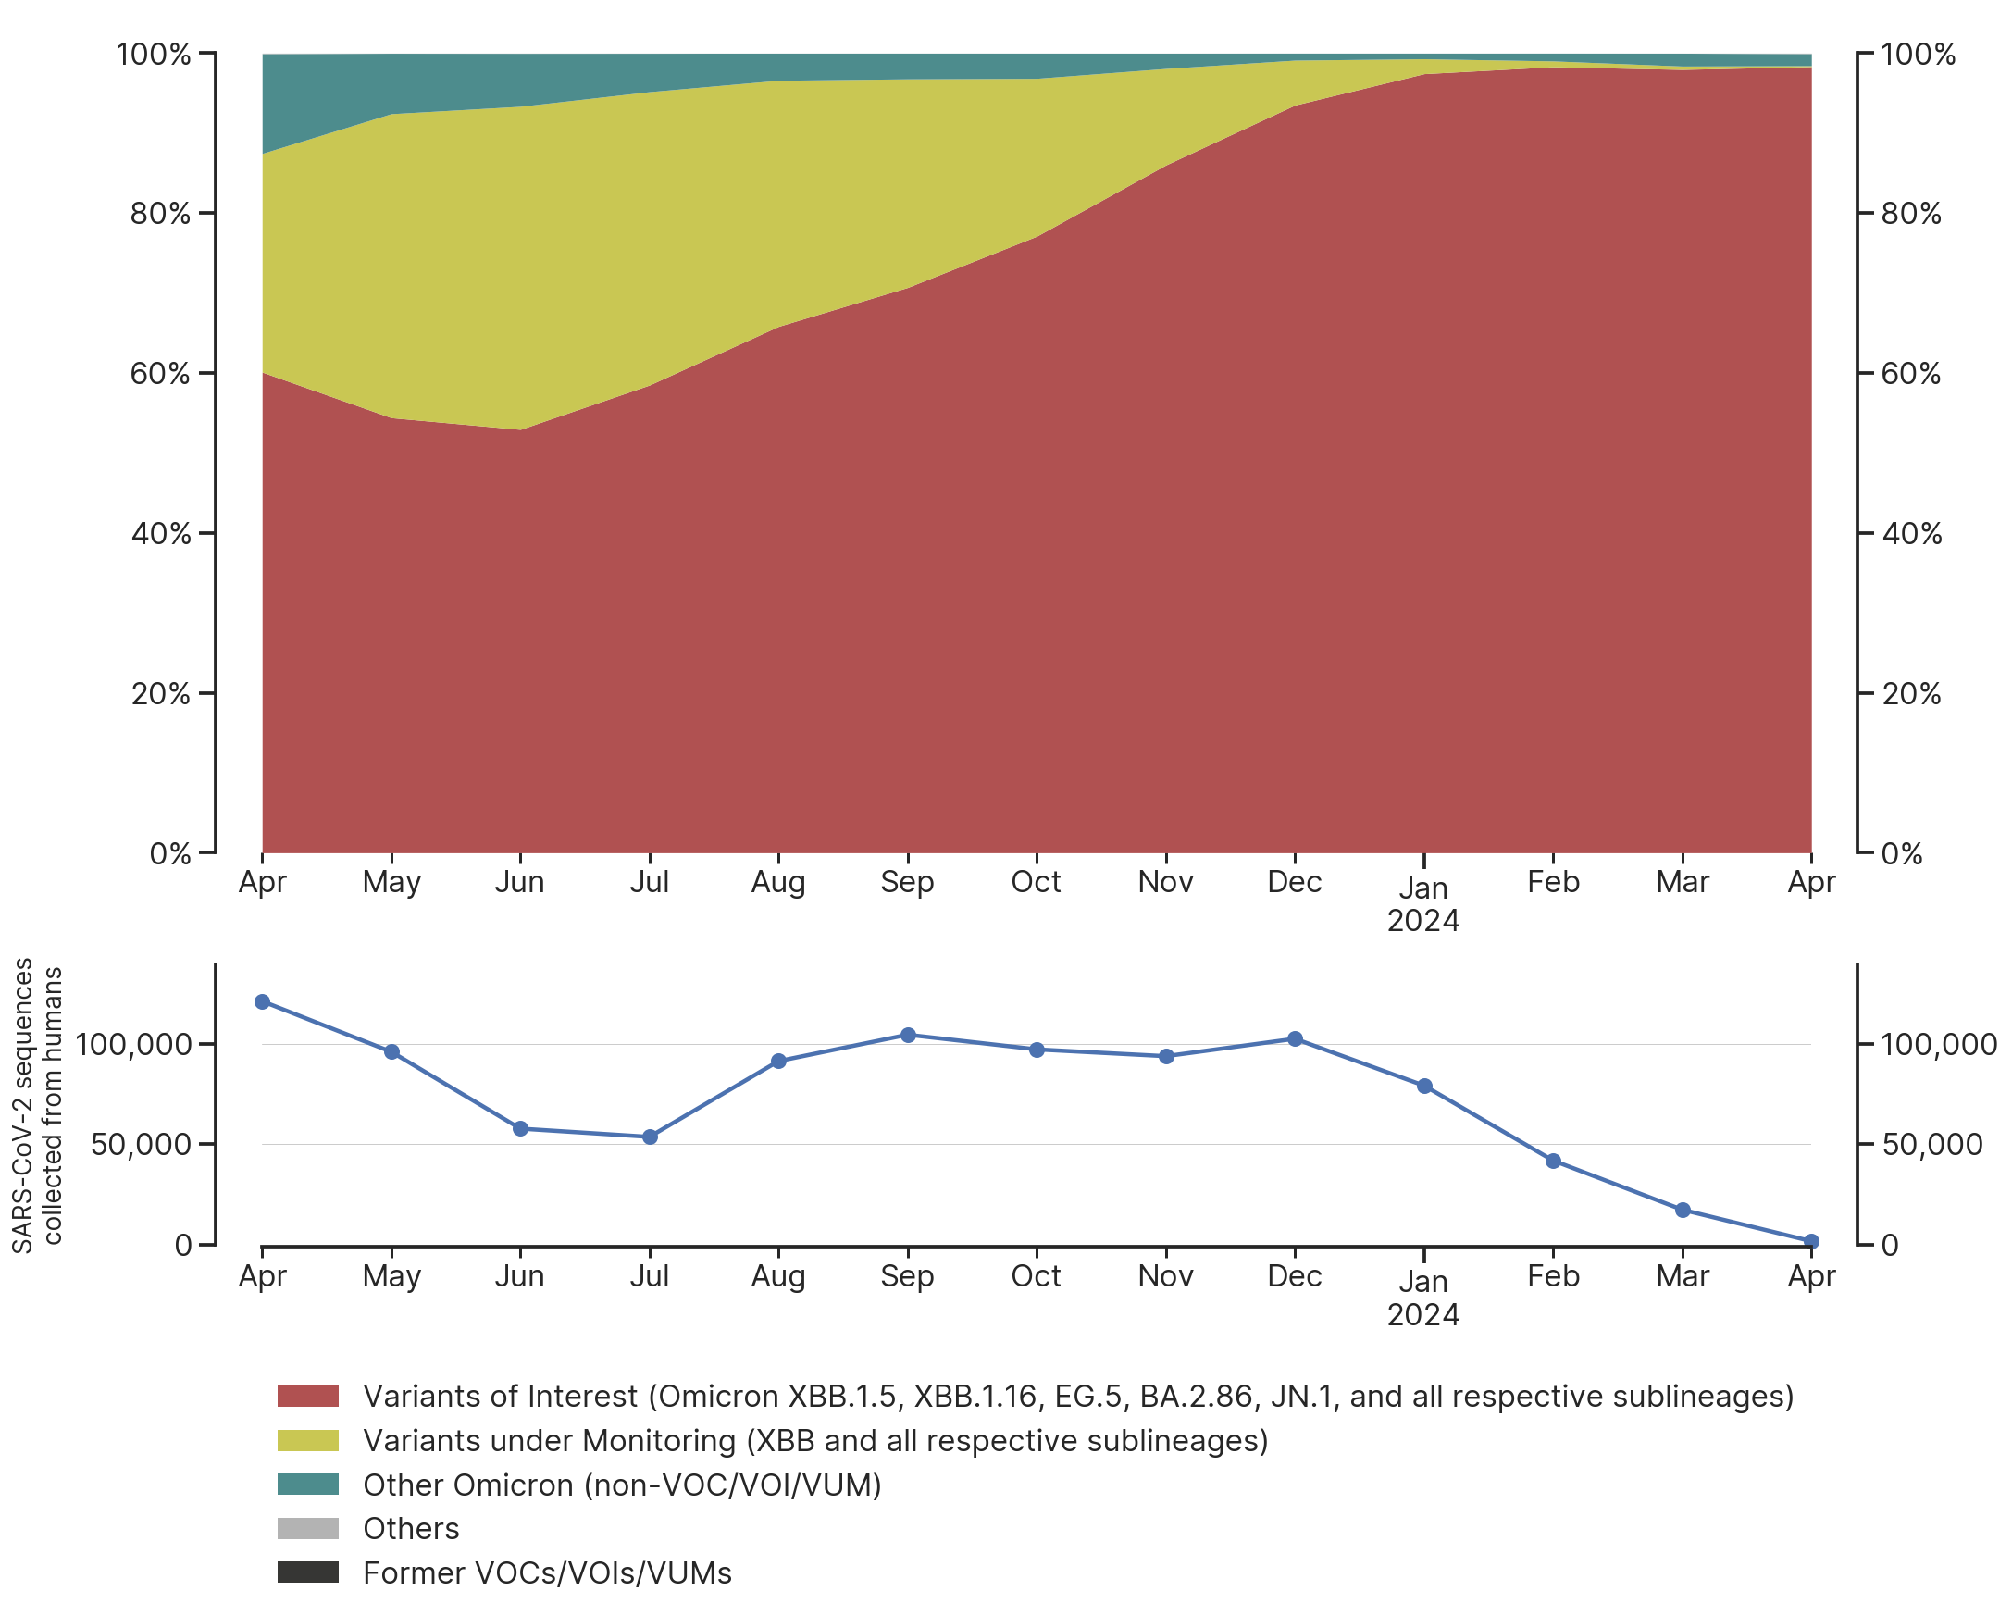
Timecourse of variant distribution in all submitted sequences
2024-04-23
Small / Variable Sample Size
We gratefully acknowledge the Authors from Originating and Submitting laboratories of sequence data on which the analysis is based.
See https://www.who.int/en/activities/tracking-SARS-CoV-2-variants/ for variant information and definitions
by BII/GIS, A*STAR Singapore

Slide 25
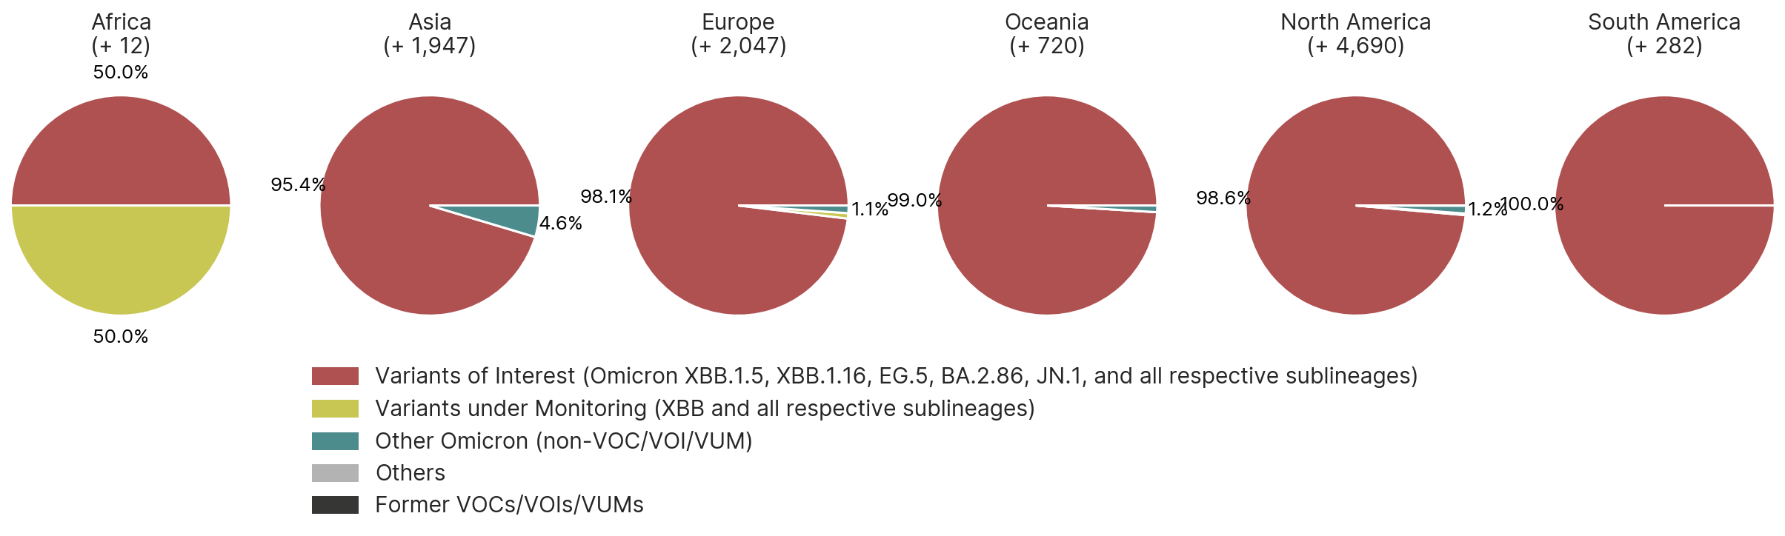
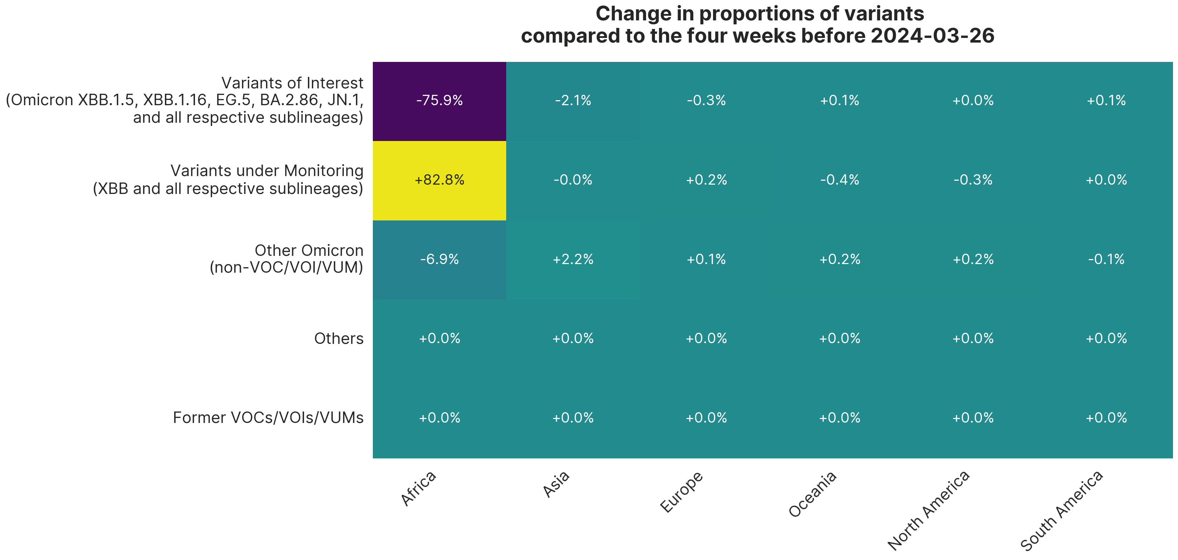
Regional distribution of variants in sequences
collected from 2024-03-26 to 2024-04-23
We gratefully acknowledge the Authors from Originating and Submitting laboratories of sequence data on which the analysis is based.
See https://www.who.int/en/activities/tracking-SARS-CoV-2-variants/ for variant information and definitions.
by BII/GIS, A*STAR Singapore

Slide 26
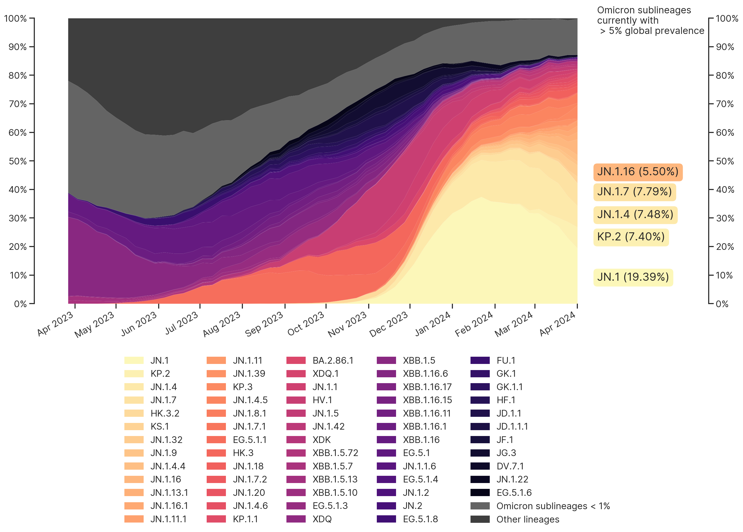
Timecourse of Omicron variant sublineage distribution
2024-04-23
We gratefully acknowledge the Authors from Originating and Submitting laboratories of sequence data on which the analysis is based.
See https://www.who.int/en/activities/tracking-SARS-CoV-2-variants/ for variant information and definitions.
by BII/GIS, A*STAR Singapore
by BII/GIS, A*STAR Singapore

Slide 27
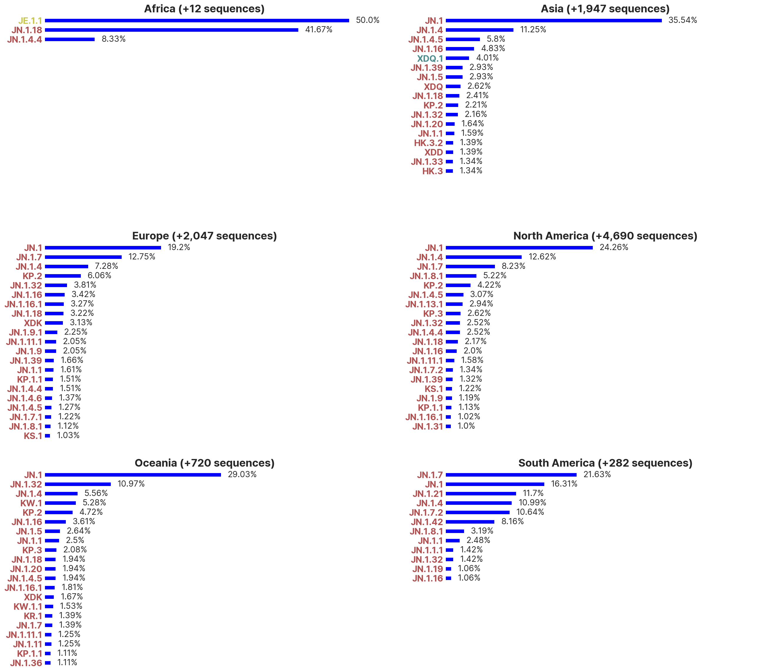
Regional trends of Omicron variant sublineages
in sequences collected from 2024-03-26 to 2024-04-23
Sublineages shown here
do not include
any descendant lineages.
We gratefully acknowledge the Authors from Originating and Submitting laboratories of sequence data on which the analysis is based.
See https://www.who.int/en/activities/tracking-SARS-CoV-2-variants for variant information and definitions.
by BII/GIS, A*STAR Singapore

Slide 28
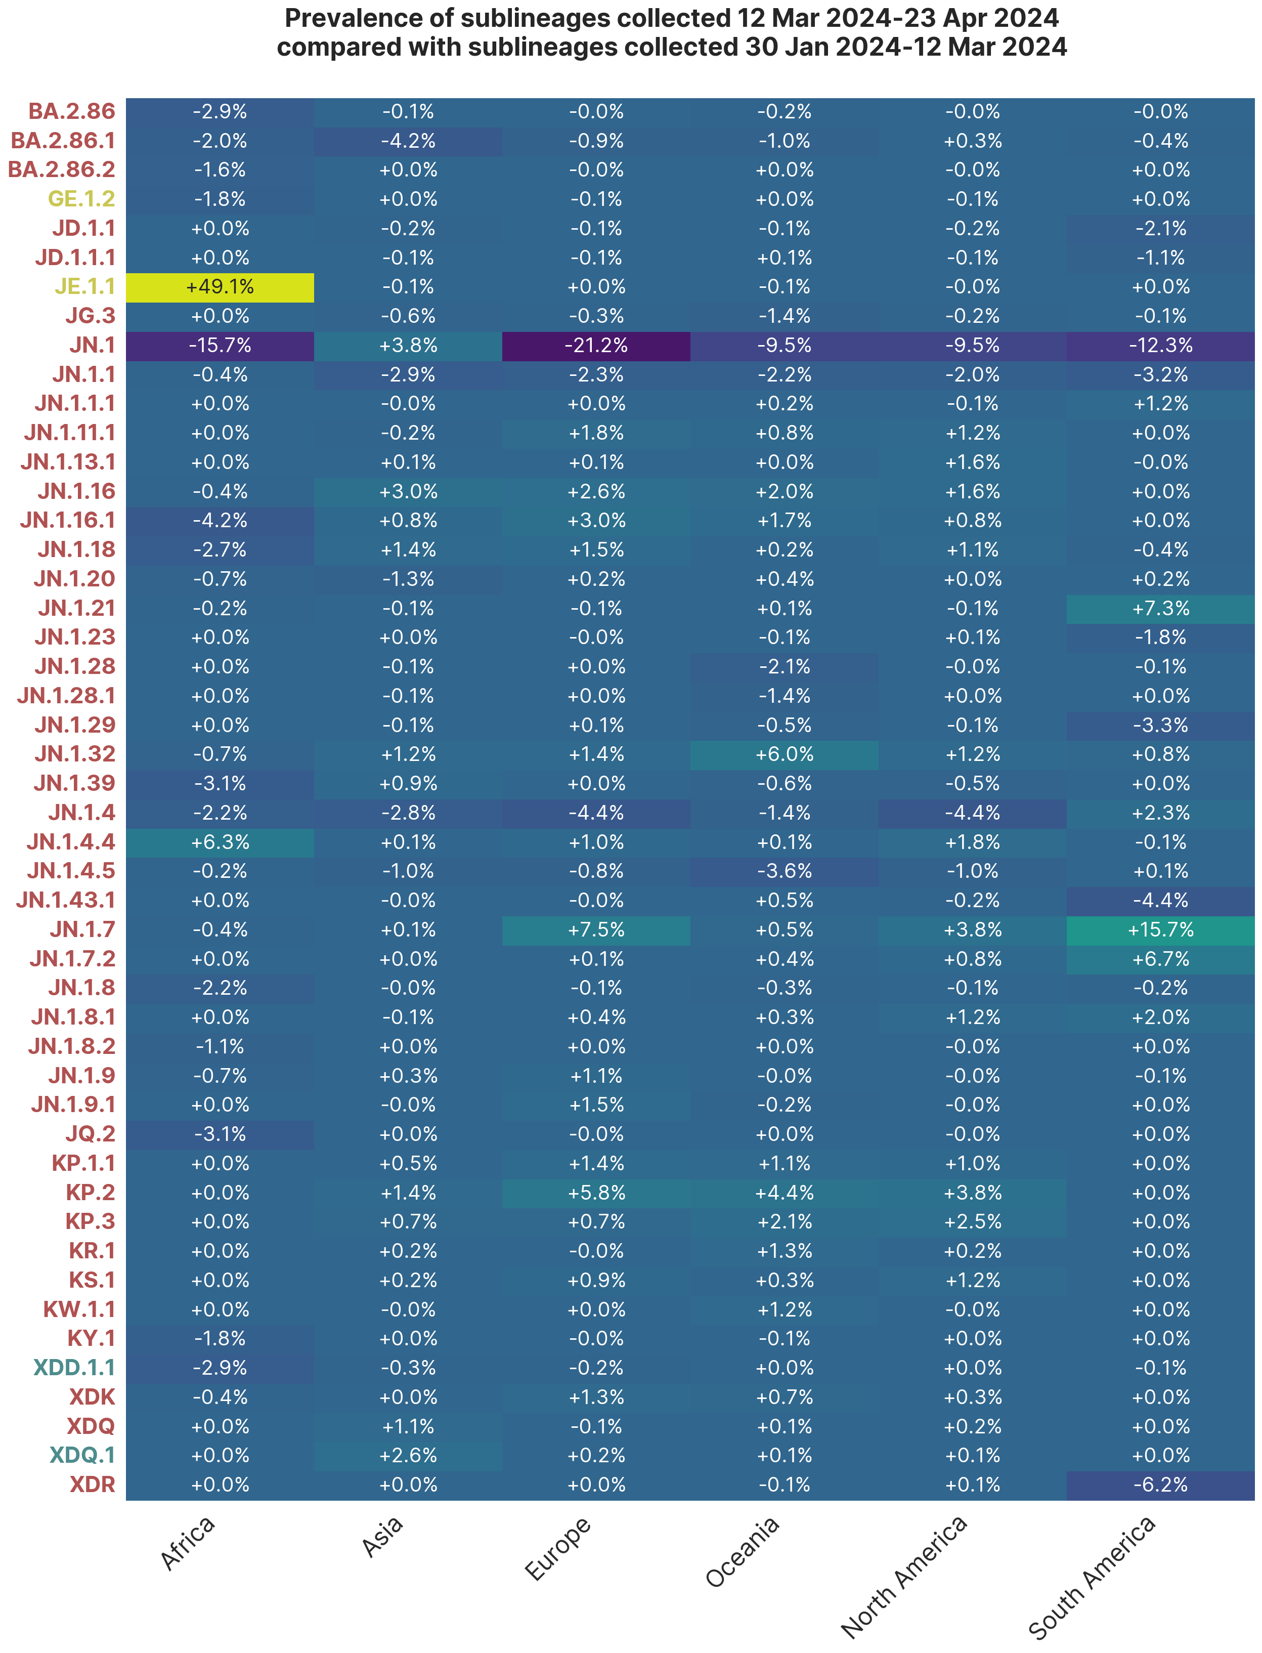
Change in proportions of Omicron sublineages
2024-04-23
Only Omicron sublineages with changes in prevalence > ±1% in the last 4 weeks are shown here.
Sublineages shown here
do not include
any descendant lineages.
We gratefully acknowledge the Authors from Originating and Submitting laboratories of sequence data on which the analysis is based.
See https://www.who.int/en/activities/tracking-SARS-CoV-2-variants for variant information and definitions.
by BII/GIS, A*STAR Singapore

Slide 29
Regional distribution of variants in new sequences
2024-04-23
 | Africa | Asia | Europe | Oceania | North America | South America
% Variants of Interest (Omicron XBB.1.5, XBB.1.16, EG.5, BA.2.86, JN.1 and sublineages) | 63.83 | 86.70 | 97.74 | 98.48 | 92.05 | 99.40
% Variants under Monitoring (Omicron XBB, and all respective sublineages) | 32.98 | 3.31 | 0.88 | 0.00 | 7.14 | 0.60
% Other Omicron (non-VOC/VOI/VUM) | 3.19 | 9.99 | 1.38 | 1.52 | 0.73 | 0
% Others | 0 | 0 | 0 | 0 | 0.08 | 0
% Former VOCs/VOIs/VUMs | 0 | 0 | 0 | 0 | 0 | 0
This slide shows NEW data in GISAID on 2024-04-23 submitted since last report 7 days ago
(new by submission date, not collection date)
See https://www.who.int/en/activities/tracking-SARS-CoV-2-variants/ for variant information and definitions
We gratefully acknowledge the Authors from Originating and Submitting laboratories of sequence data on which the analysis is based.
by BII/GIS, A*STAR Singapore

Slide 30
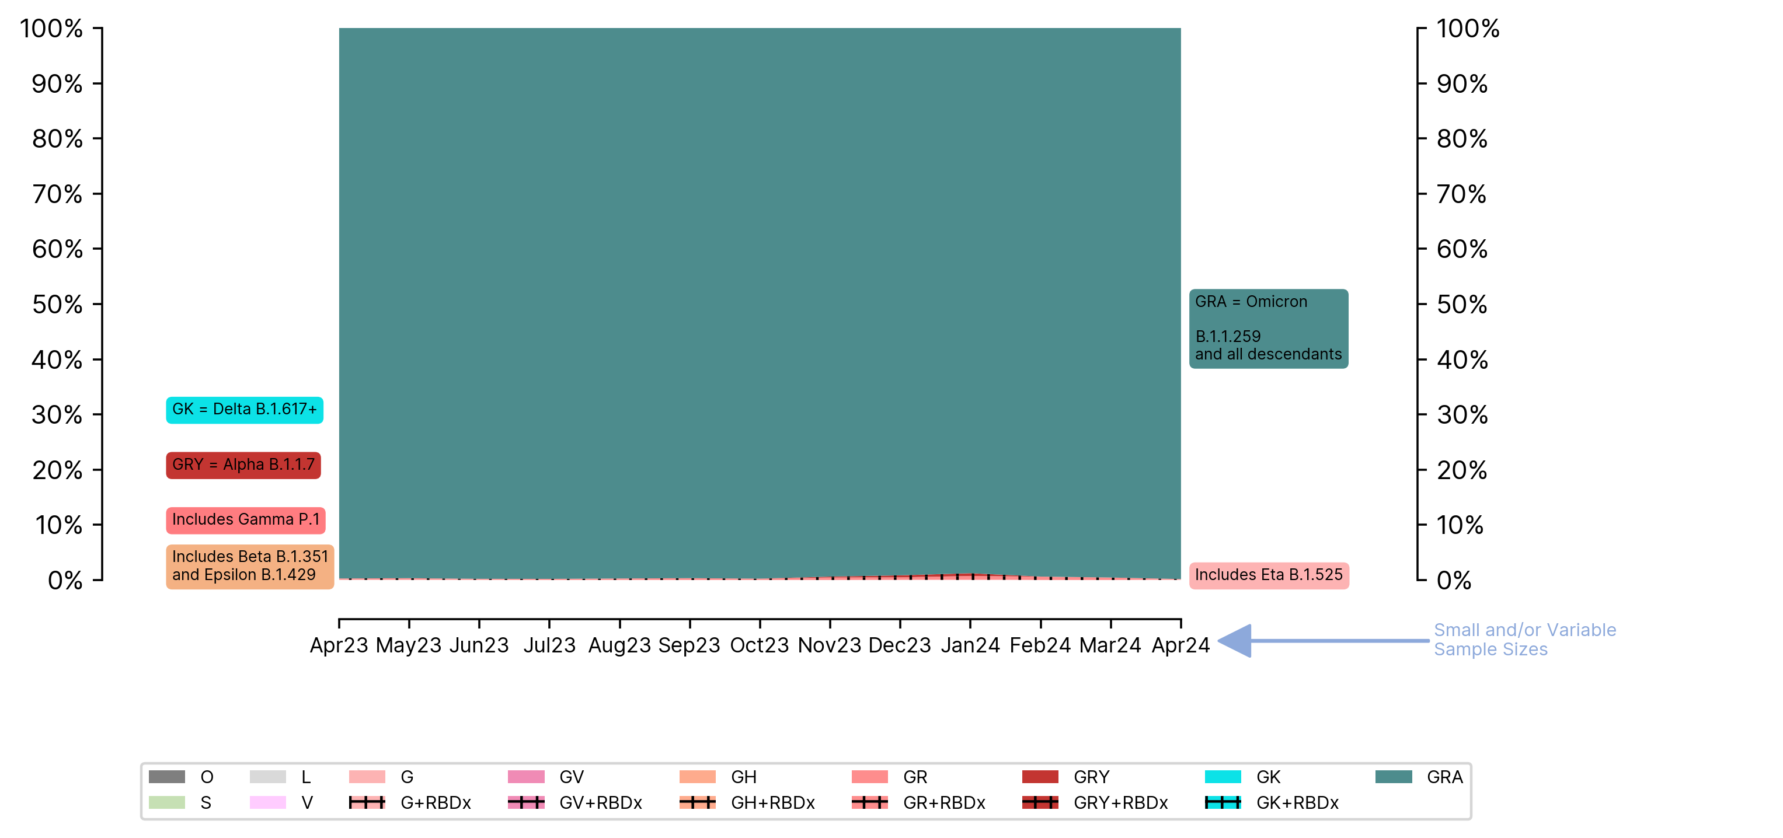
Clade references and Pango lineages
Larger clades in GISAID were named in context of marker variants relative to WIV04-reference:
S C8782T,T28144C includes NS8-L84S
L C241,C3037,A23403,C8782,G11093,G25563,G26144,T28144,G28882 (WIV04-reference)
V G11093T,G26144T includes NSP6-L37F + NS3-G251V
G C241T,C3037T,A23403G S-D614G
GK C241T,C3037T,A23403G,C22995A includes S-D614G + S-T478K
GH C241T,C3037T,A23403G,G25563T includes S-D614G + NS3-Q57H
GV C241T,C3037T,A23403G,C22227T includes S-D614G + S-A222V
GR C241T,C3037T,A23403G,G28882A includes S-D614G + N-G204R
GRY C241T,C3037T,21765-21770del,21991-21993del,A23063T,A23403G,G28882A includes S-H69del, S-V70del, S-Y144del, S-N501Y + S-D614G + N-G204R
GRA: C241T,C3037T,A23403G,G28882A includes S-D614G + N-G204R + (at least 6 of the following amino acid changes S-V143del,S-Y145del,S-N211del,S-ins214EPE,S-G339D,S-S371L,S-S477N,S-T478K,S-E484A,S-Q493R,S-Q498R,S-T547K,S-N679K,S-P681H,S-P681R,S-N764K,S-D796Y,S-N856K,S-Q954H,S-N969K,S-L981F)
Timecourse of clade distribution in collected sequences
2024-04-23
We gratefully acknowledge the Authors from Originating and Submitting laboratories of sequence data on which the analysis is based.
RBDx: Relevant changes near receptor and antibody binding sites (relative to clade reference)
by BII/GIS, A*STAR Singapore

Slide 31
Regional clade distribution of new sequences
2024-04-23
 | Africa | Asia | Europe | Oceania | North America | South America
Total | 121,931 | 1,494,291 | 7,337,279 | 237,957 | 5,186,313 | 390,966
New | 99 | 1,993 | 1,525 | 330 | 2,647 | 504
We gratefully acknowledge the Authors from Originating and Submitting laboratories of sequence data on which the analysis is based.
This slide shows NEW data in GISAID on 2024-04-23 submitted since last report 7 days ago
(new by submission date, not collection date).
by BII/GIS, A*STAR Singapore

Slide 32
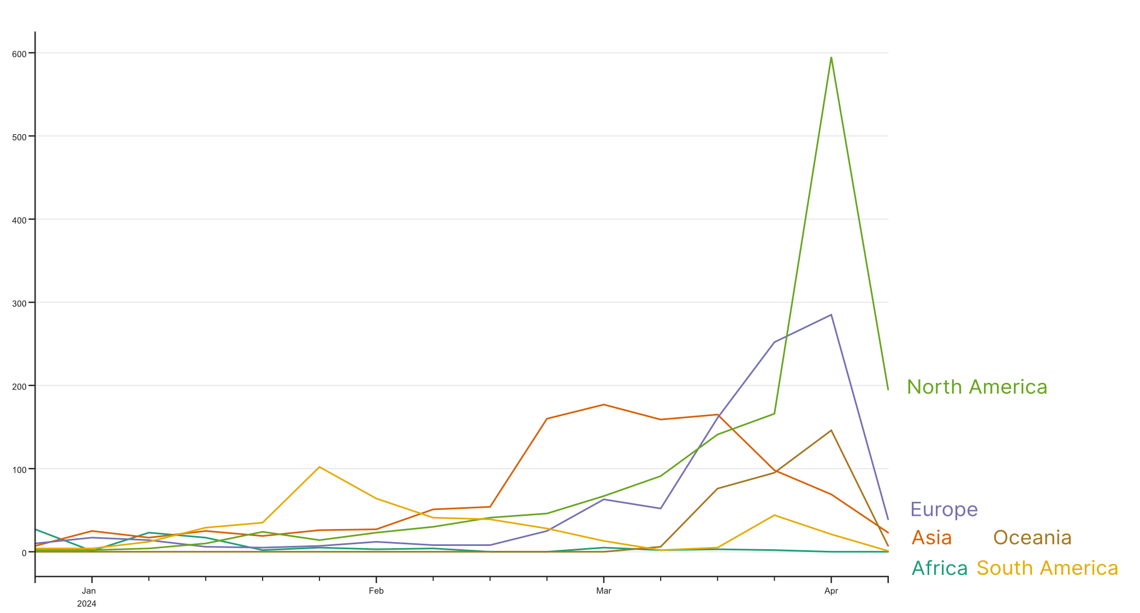
Distribution of collection dates of new sequences
2024-04-23
We gratefully acknowledge the Authors from Originating and Submitting laboratories of sequence data on which the analysis is based.
This slide shows NEW data in GISAID on 2024-04-23 submitted since last report 7 days ago
(new by submission date, not collection date).
by BII/GIS, A*STAR Singapore

Slide 33
Breakdown of new sequences by clade, then by territory
2024-04-23
S clade [#RBDx] 17,168 [6,453] (+0 [+0])
L clade [#RBDx] 6,430 [163] (+1 [+0]): 1 USA/TX
V clade [#RBDx] 6,708 [42] (+0 [+0])
G clade [#RBDx] 301,690 [124,972] (+12 [+12]): 8 [8] USA/TN, 3 [3] Nigeria, 1 [1] USA/CA
GR clade [#RBDx] 504,269 [267,017] (+69 [+67]): 31 [30] USA/CA, 13 [12] env, 6 [6] USA/TN, 4 [4] Kenya, 3 [3] Australia/NSW, 3 [3] Trinidad and Tobago, 2 [2] France, 1 [1] USA/MN, 1 [1] Pakistan, 1 [1] Russia, 1 [1] USA/TX, 1 [1] USA/VA, 1 [1] Malaysia, 1 [1] USA/LA
GRY clade [#RBDx] 1,046,555 [115,818] (+0 [+0])
GH clade [#RBDx] 535,088 [237,727] (+27 [+2]): 27 [2] USA/CA
GV clade [#RBDx] 174,836 [9,929] (+0 [+0])
GK clade [#RBDx] 4,174,020 [663,540] (+0 [+0])
GRA clade 7,955,624 (+6,985): 1,158 Japan, 982 USA/CA, 438 USA/TN, 401 Russia, 393 Canada, 392 England, 389 Brazil, 290 Sichuan, 166 Australia/NSW, 156 Spain, 135 USA/MN, 114 USA/IL, 108 USA/NY, 102 env, 100 Taiwan, 95 Hubei, 90 Australia/QLD, 88 Italy, 84 France, 82 Liaoning, 75 Puerto Rico, 74 Chile, 71 Australia/SA, 65 Ukraine, 63 Scotland, 63 Sweden, 59 Henan, 51 Gansu, 50 Kenya, 50 Wales, 45 Anhui, 44 USA/HI, 42 USA/VA, 40 Mauritius, 39 Germany, 38 USA/NJ, 32 Malaysia, 31 Peru, 29 USA/OH, 28 Ireland, 24 USA/MI, 19 USA/IA, 19 USA/MS, 18 Pakistan, 18 USA/TX, 17 Switzerland, 14 USA/MD, 14 USA/WA, 12 USA/NC, 12 Poland, 12 USA/FL, 10 USA/PA, 8 Qatar, 5 USA/MA, 5 USA/LA, 4 Trinidad and Tobago, 3 USA/DE, 3 USA/AZ, 3 USA/NV, 2 Canary Islands, 2 USA/WI, 2 Nigeria, 2 USA/DC, 1 USA/KY, 1 USA/GA, 1 USA/SC, 1 USA/CO, 1 USA/WV
Other clade [#RBDx] 46,345 [31,930] (+0 [+0])
This slide shows NEW data in GISAID on 2024-04-23 submitted since last report 7 days ago (new by submission date, not collection date)
RBDx: Relevant changes near receptor and antibody binding sites (relative to clade reference)
by BII/GIS, A*STAR Singapore

Slide 34
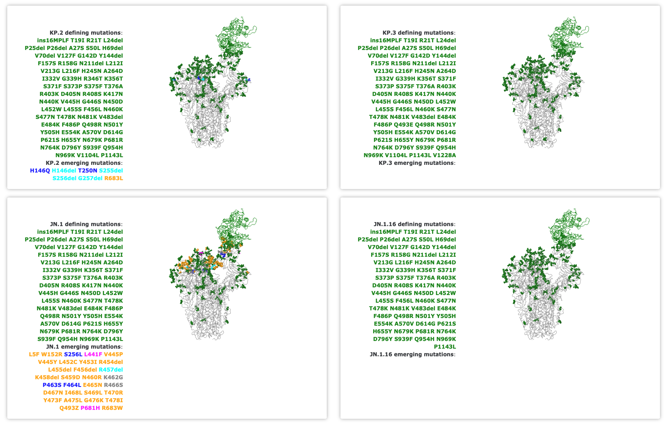
Spike glycoprotein mutation surveillance 2024-04-23
Changes in the spike glycoprotein for the top 4 spreading lineages based on 9,185 sequences collected in the past 60 days.
Full list at www.gisaid.org/spike
Numbering relative to start codon 21,563 in hCoV-19/Wuhan/WIV04/2019
● Spike glycoprotein variation found in ≤ 100 sequences
● Spike glycoprotein variation found in >100 sequences
● Spike glycoprotein variation found in ≥ 10% of sequences from the lineage
lineage defining mutations: amino acid changes found
in ≥ 10% of sequences in the lineage
● Spike glycoprotein variation near host receptor, or other functional annotation
● Insertion/deletion
● Spike glycoprotein variation altering potential N-glycosylation sites
lineage emerging mutations: amino acid changes found in <10% of sequences in the lineage that are also found in top 50 emerging constellations by Spread and top 20 emerging constellations by Acceleration (See emerging variant analysis for details)
We gratefully acknowledge the Authors from Originating and Submitting laboratories of sequence data on which the analysis is based.
by BII/GIS, A*STAR Singapore

Slide 35
Receptor binding surveillance for complete genomes 2024-04-23
New occurrence in the spike glycoprotein for the top 4 spreading lineages based on 9.185 sequences collected in the past 60 days.
Full list at www.gisaid.org/spike
JN.1
L5F (66x): 17x in Canada
P681H (37x)
V445P (15x)
S256L (10x)
R683W (9x)
L441F (7x)
T478I (4x)
Q493Z (3x)
W152R (3x)
Y473F (2x)
T470R (2x)
A475L (2x)
D467N (2x)
S469L (2x)
R466S (2x)
G476K (2x)
I468L (2x)
KP.2
H146Q (29x)
H146del (5x)
S256del (2x)
S255del (2x)
T250N (2x)
G257del (2x)
R683L (2x)
We gratefully acknowledge the Authors from Originating and Submitting laboratories of sequence data on which the analysis is based.
Numbering relative to start codon 21,563 in hCoV-19/Wuhan/WIV04/2019
by BII/GIS, A*STAR Singapore

Slide 36
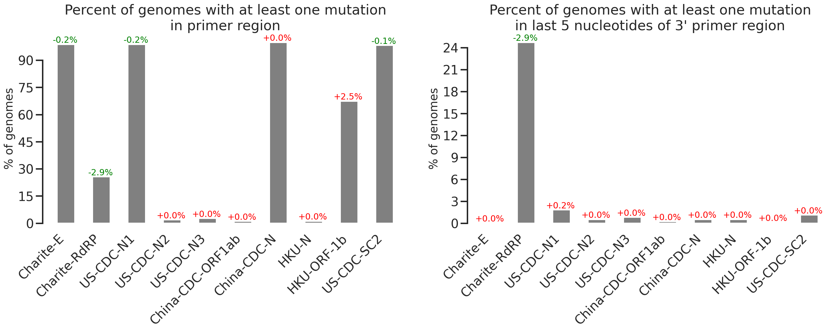
Common Primer Check for High Quality Genomes 2024-04-23
To reduce noise, 125,922 available high-quality genomes out of 128,045 entries submitted in the past 90 days are considered here.
Each bar is annotated with the change in percentage since the previous update.
This is a simplified summary view of the percent of high quality genomes (defined as <1% Ns and <0.05% unique non-synonymous mutations) with one or more mutations in either forward, probe or reverse primer region. This does not necessarily indicate a primer would not function but serves as a guide to variability of the targeted region. The second Figure shows the same but with mutations in 3’ ends for the primer regions (defined as last 5 nucleotides of the primer sequence) which can affect sensitivity partially.
Sources of primer sequences (may have been updated in meantime): https://www.who.int/docs/default-source/coronaviruse/protocol-v2-1.pdf
https://www.who.int/docs/default-source/coronaviruse/peiris-protocol-16-1-20.pdf
http://ivdc.chinacdc.cn/kyjz/202001/t20200121_211337.html
https://www.who.int/docs/default-source/coronaviruse/uscdcrt-pcr-panel-primer-probes.pdf
We gratefully acknowledge the Authors from Originating and Submitting laboratories of sequence data on which the analysis is based.
by BII/GIS, A*STAR Singapore

