Slide 1

Latest update
EpiFlu™ - EpiCoV™ - EpiRSV™ - EpiPox™
2025-01-09

Slide 2
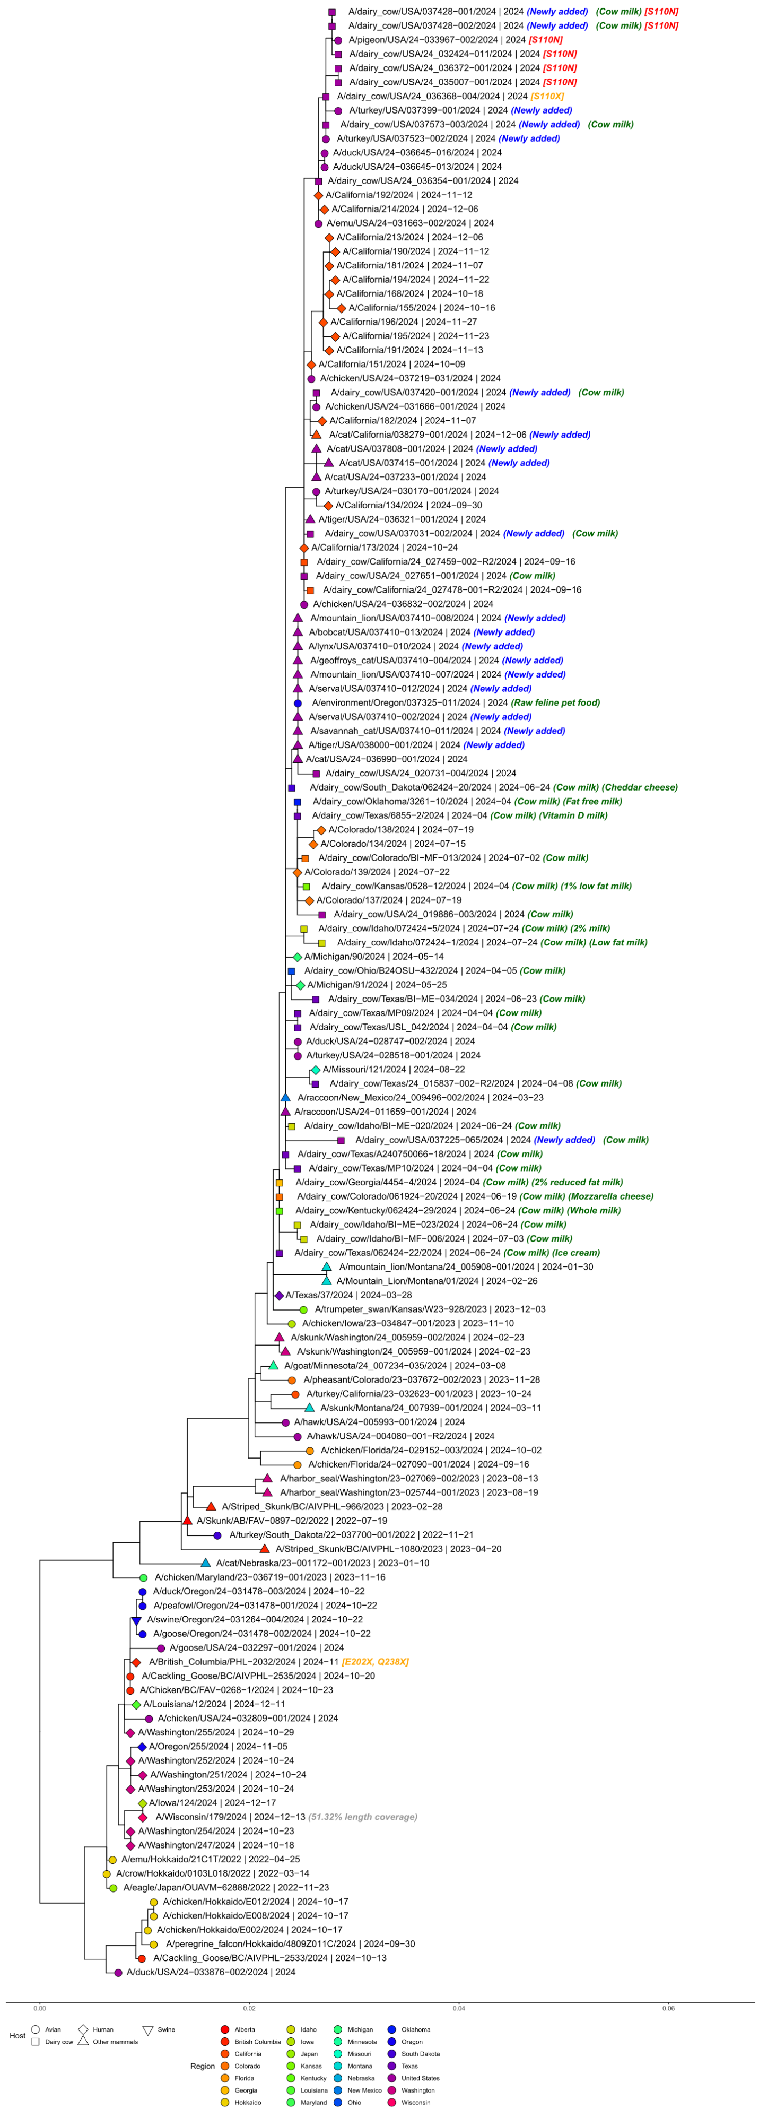
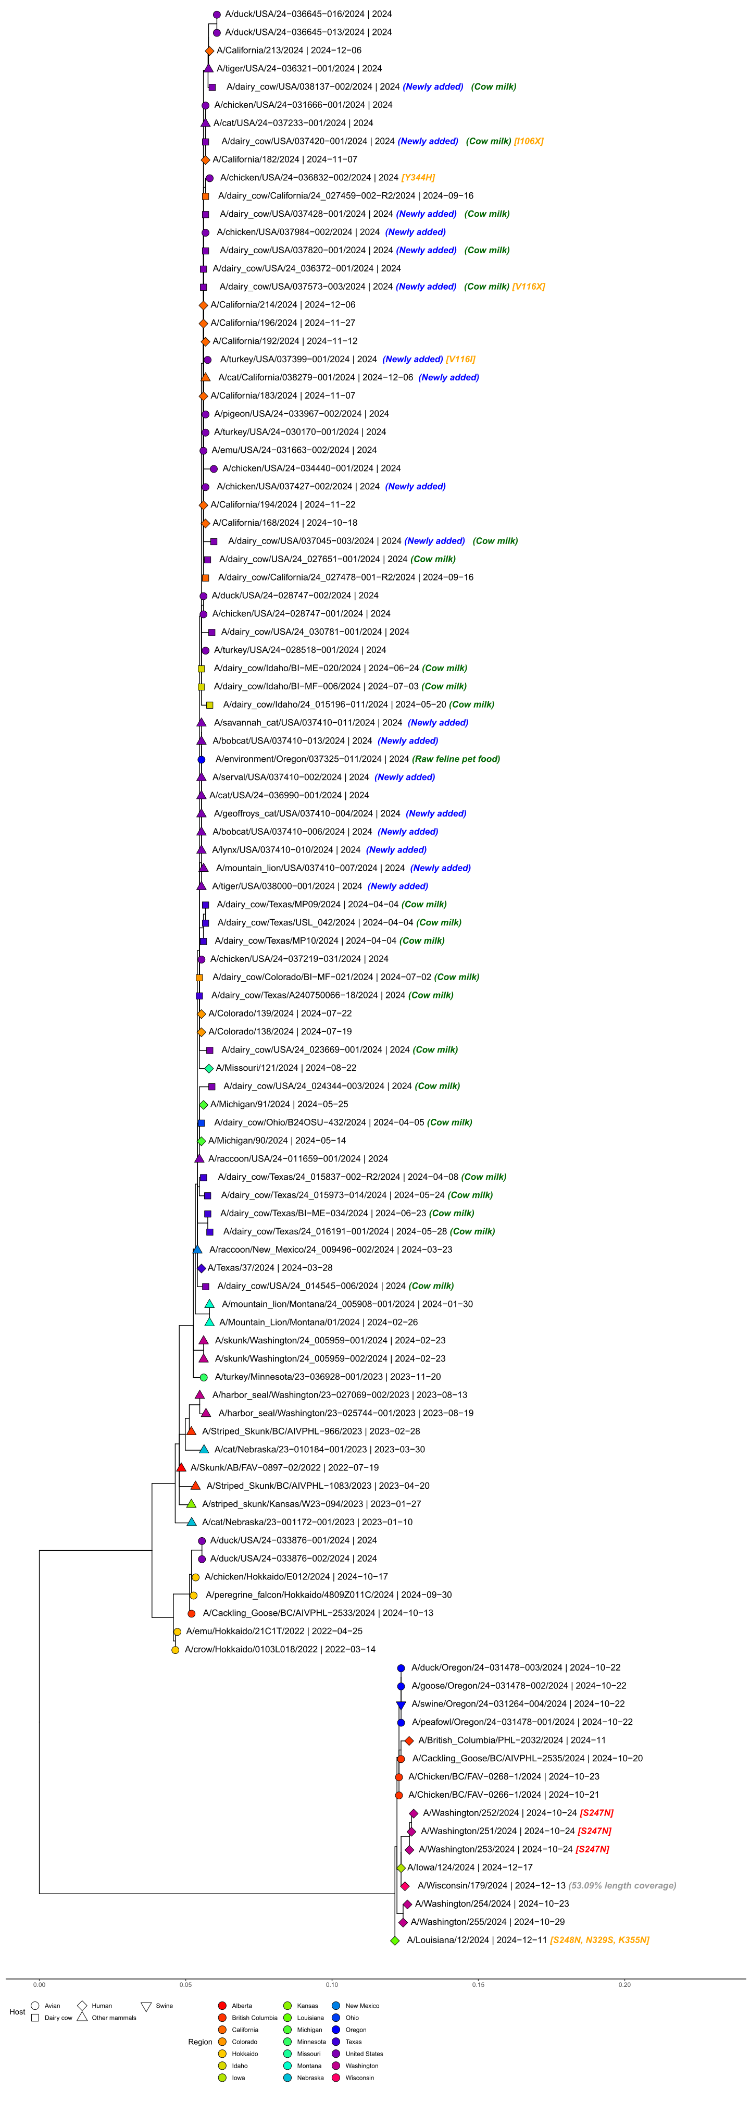
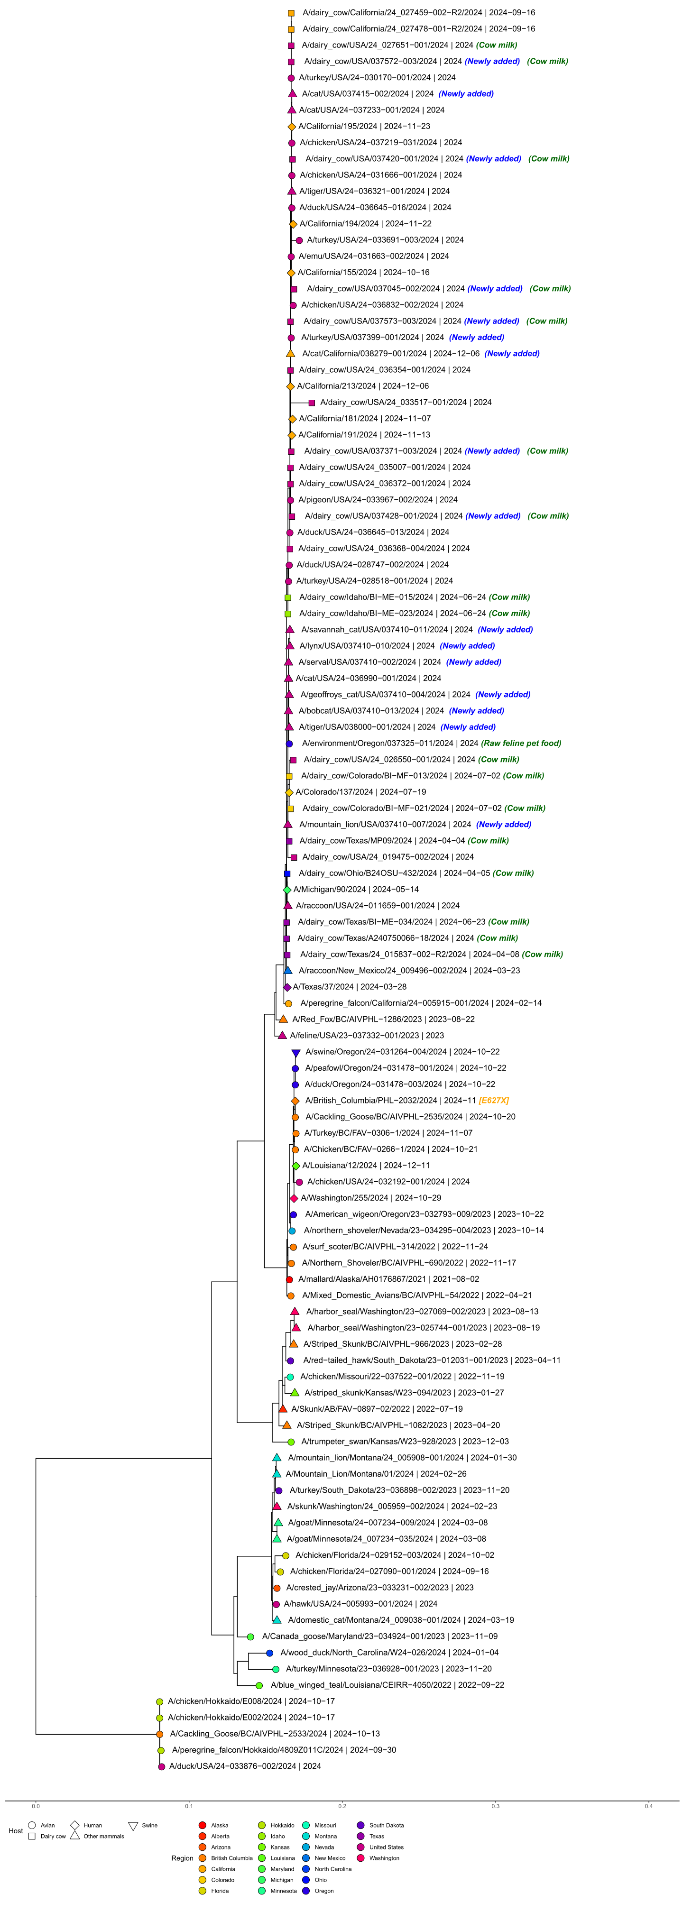

EpiFlu™ Update
H5N1 Bird Flu continues to affect the United States and now British Columbia
The outbreak of H5N1 (Clade 2.3.4.4b) across the U.S.
continues, with the CDC now confirming 66 human
cases, mostly involving dairy and poultry farm workers,
and a first case of a child in California with an unknown
route of infection. Other cases involve the HPAI virus in
swine, about 919 dairy herds, over 133 million poultry
and countless migratory birds.
The route of exposure of dairy cows and mode of virus
transmission remains unknown. The virus RNA was
found at high concentrations in raw milk. Several animal
species at dairy and poultry farms, as well as a growing
number of farm workers, are affected.
Data from the USDA’s Animal and Plant Health
Inspection Service show that the viruses in infected
cows, other animals, and the farm workers are closely
related. A mammalian adaptation marker (E627K) was
noted in only one farm worker so far, with nearly all
farm workers developing mild eye symptoms, alongside
respiratory symptoms. Over a thousand full virus
genome sequences from this outbreak, collected from
mammalian and avian specimens in both the U.S. and
B.C. are shared via GISAID EpiFlu.
On December 30th, the CDC released initial specimen data (HA and NA segments) from the first human H5N1 cases in Iowa and Wisconsin, collected from farm workers exposed to infected poultry. Earlier, on December 11th, the CDC released data from the first severe U.S. HPAI case in Louisiana, matching the D1.1 genotype found in poultry, wild birds, and recent human cases in Washington state and British Columbia. The latest trees, based on representative subsamples, are dated to 7 January 2025.
Track the U.S. H5N1 outbreak here
Hemagglutinin (HA)
Neuraminidase (NA)
Polymerase basic 2 (PB2)
Subsampled phylogenetic trees with focus on recent U.S. H5N1 samples shown for HA, NA or PB2, respectively (as of 7. January 2025)
by FIOCRUZ, Brazil

Slide 3
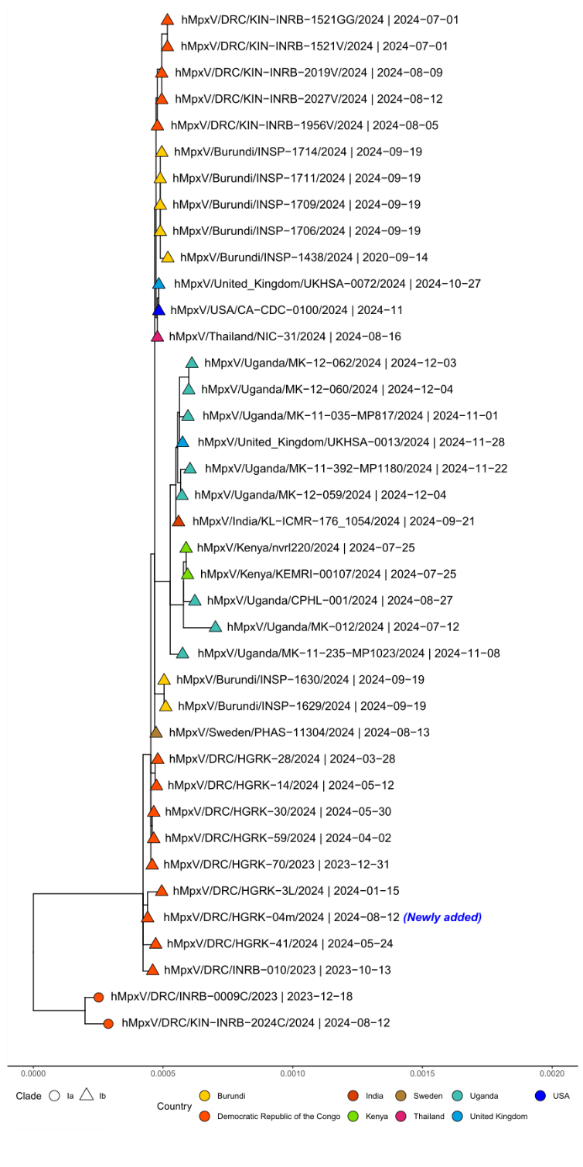
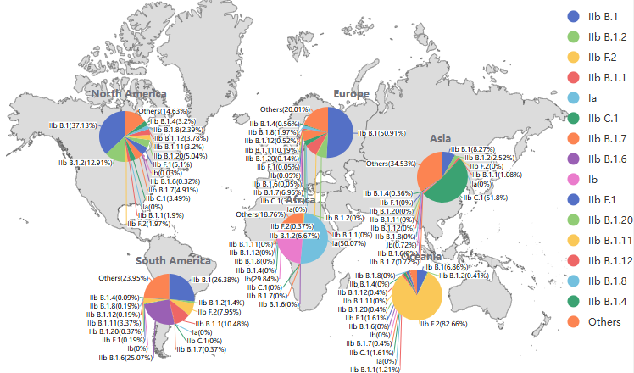
EpiPox™ Update
Mpox virus Clade Ib
Since November 2023, the Eastern parts of the Democratic Republic of the
Congo (DRC) continue to see a significant number of cases of the mpox virus
Clade Ib that is spreading through regional travel to neighboring countries
incl. Burundi, Kenya, Rwanda, and Uganda. Outside of Africa, the number of
imported cases is increasing and reported in Canada, France, Germany, India,
Sweden, Thailand, United Kingdom and the United States.
GISAID EpiPox currently provides access to 325 genome sequences and
associated metadata of the mpox virus Clade Ib. According to the CDC, early
data indicate that a large proportion of Clade Ib cases among adults are
associated with intimate human contact, including via ongoing transmission
believed to be occurring in some countries where the virus is not normally
found. For more see phylodynamics of Mpox Clade I
Lineage distribution (as of 9 Jan 2025)
Phylogenetic tree with focus on clade Ib (as of 19. December 2024)
by FIOCRUZ, Brazil

Slide 4
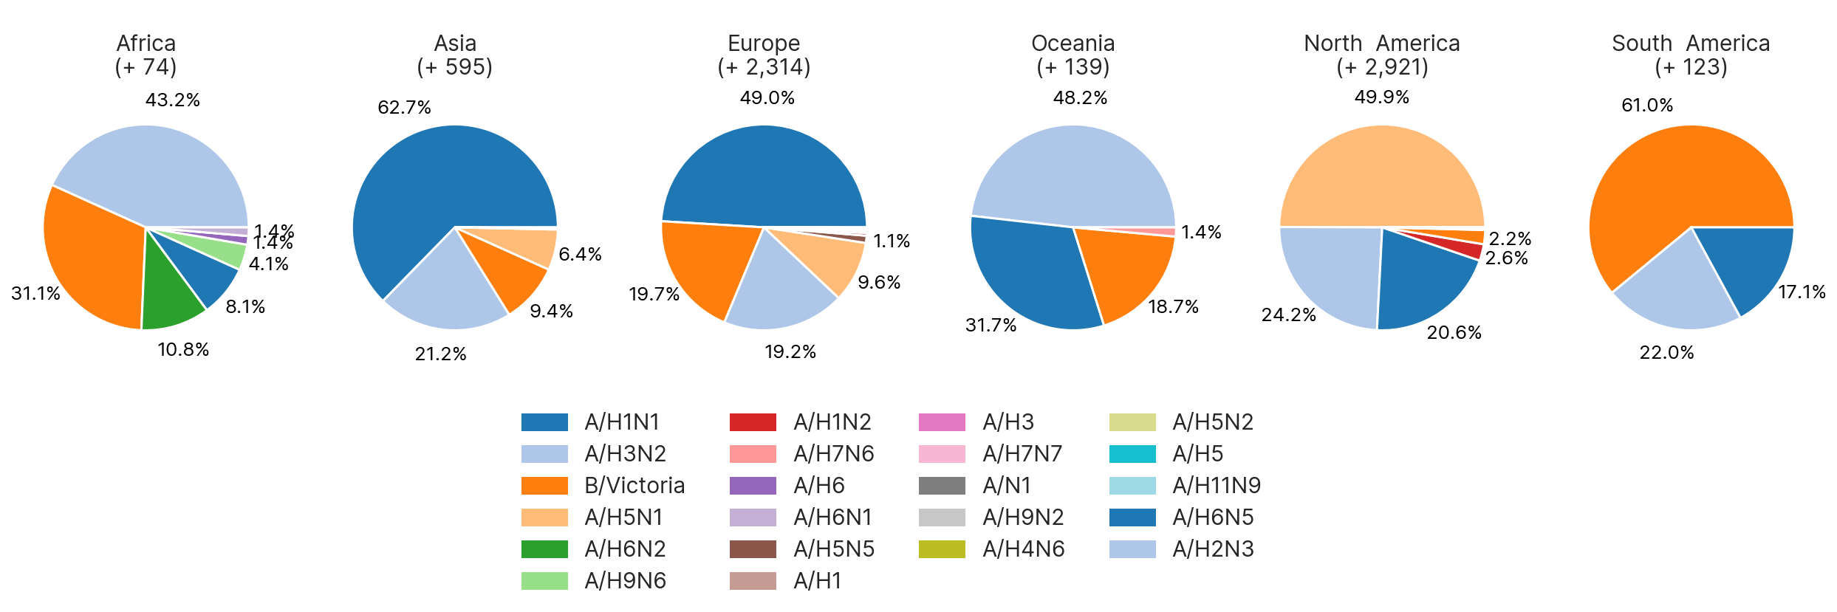
Regional distribution of subtypes in new influenza sequences
collected from 2024-10-01 to 2025-01-01
EpiFlu™ Update

Slide 5
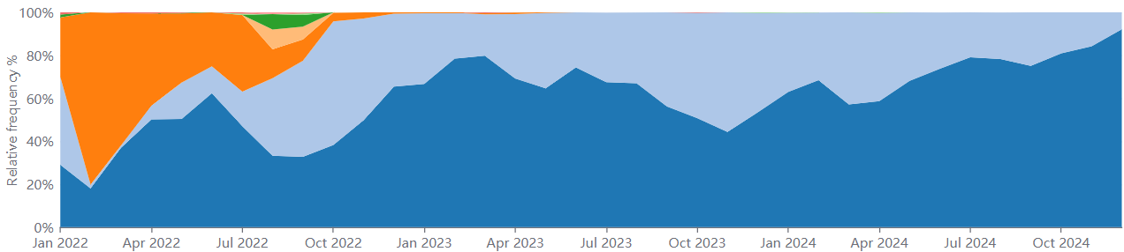
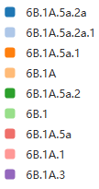
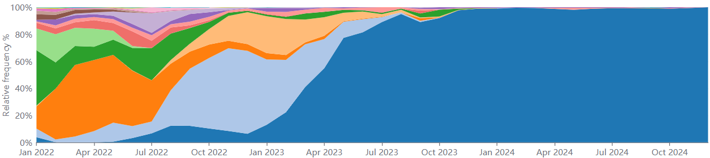
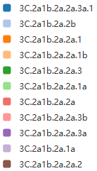
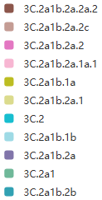

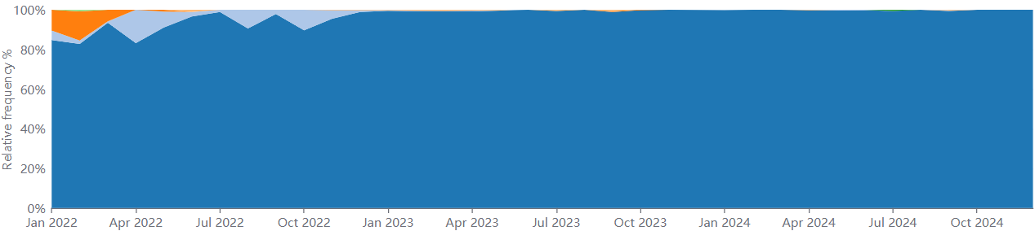
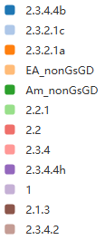
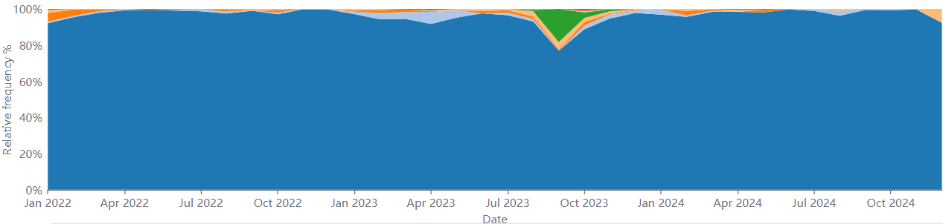

EpiFlu™ Update
Clade progression in all sequences submitted to EpiFluTM
2025-01-09
A/H1
A/H3
B/Victoria
A/H5 (Human + Animal)

Slide 6
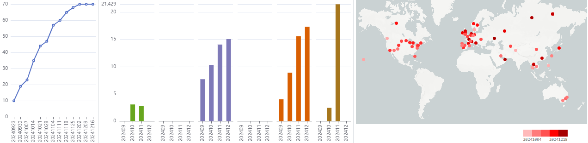
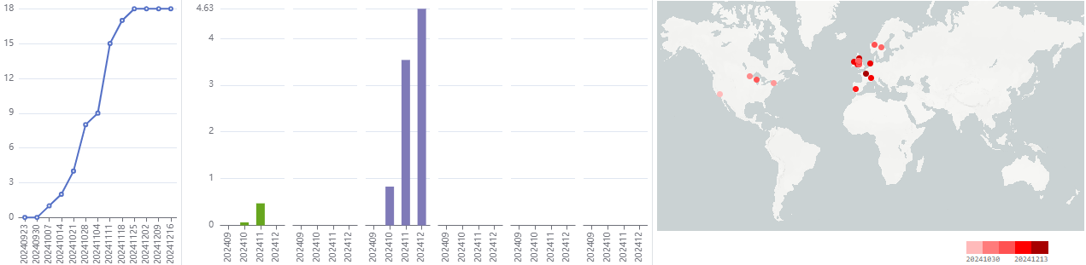
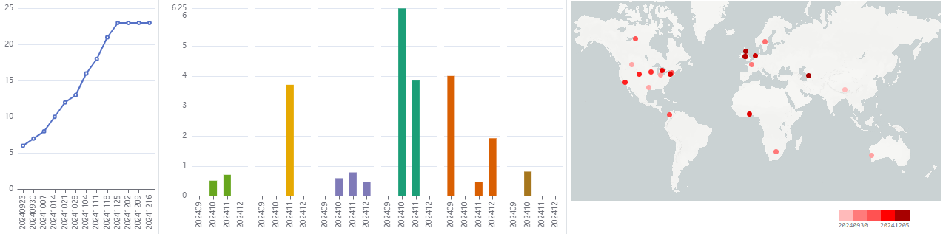
Emerging variant analysis 2025-01-07
EpiFlu™ Update
Influenza Emerging Variants by Spread
Subtype/Clade
Count^
Cumulative
locations
North
America
South
America
geoMap
Differentiating Mutations*
Europe
Africa
Asia
Oceania
H1N1pdm/6B.1A.5a.2a
458
% prevalence
H1N1pdm/6B.1A.5a.2a
70
+HA_A15V, +HA_I183V
% prevalence
H3N2/3C.2a1b.2a.2a.3a.1
40
% prevalence
^Count in past 100 days from analysis date
*All amino acid changes were tracked for HA sequences collected in the last 100 days. Next, only amino acid changes that have gained >=4 new locations in the last 50 days were selected to be part of a variant mutation signature (constellation). Each row represents a unique emerging variant mutation signature. Differentiating mutations refer to the amino acid changes in the emerging variant that set it apart from all other emerging variants in the first 50 days.

Slide 7
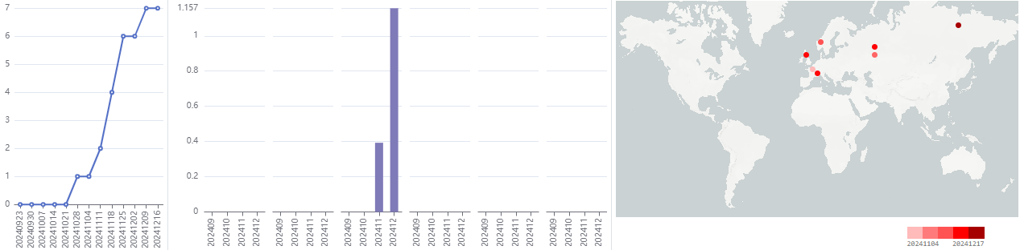
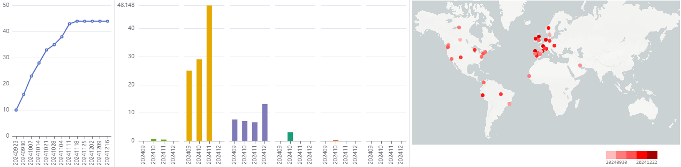
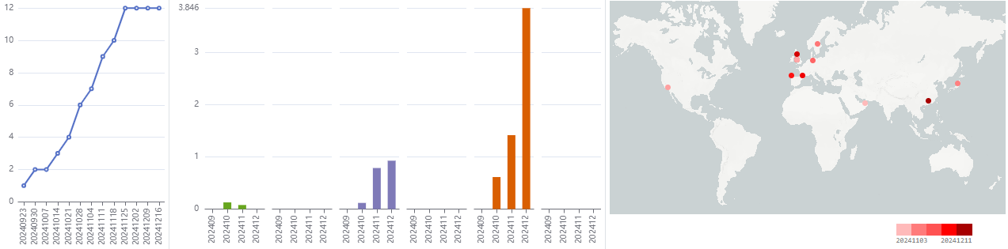
Emerging variant analysis 2025-01-07
EpiFlu™ Update
Influenza Emerging Variants by Spread
Subtype/Clade
Count^
Cumulative
locations
North
America
South
America
geoMap
Differentiating Mutations*
Europe
Africa
Asia
Oceania
H1N1pdm/6B.1A.5a.2a
9
+HA_D52N
% prevalence
BVic/V1A.3a.2
250
+HA_E143K
% prevalence
H1N1pdm/6B.1A.5a.2a
23
+HA_P154S
% prevalence
^Count in past 100 days from analysis date
*All amino acid changes were tracked for HA sequences collected in the last 100 days. Next, only amino acid changes that have gained >=4 new locations in the last 50 days were selected to be part of a variant mutation signature (constellation). Each row represents a unique emerging variant mutation signature. Differentiating mutations refer to the amino acid changes in the emerging variant that set it apart from all other emerging variants in the first 50 days.

Slide 8
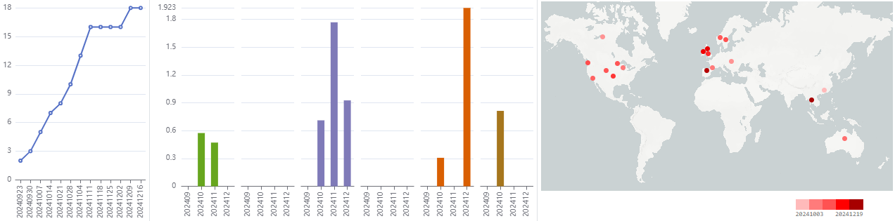
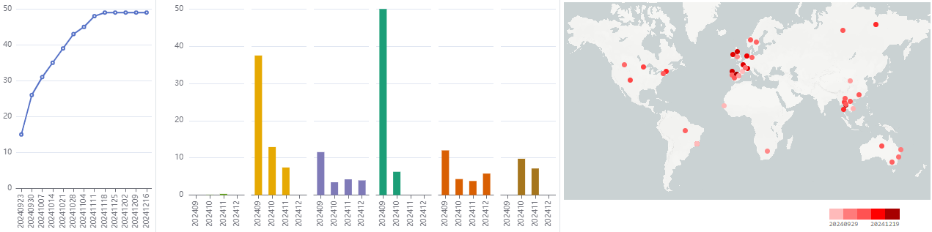
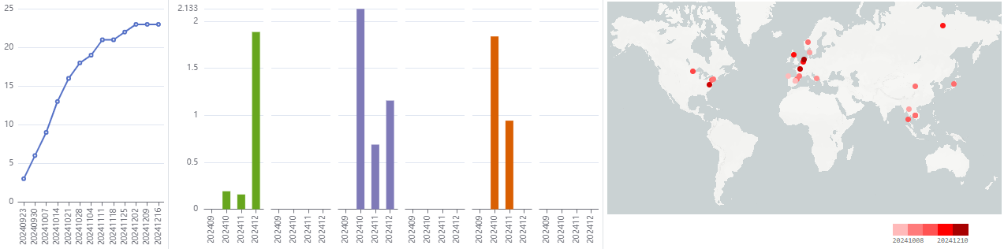
Emerging variant analysis 2025-01-07
EpiFlu™ Update
Influenza Emerging Variants by Spread
Subtype/Clade
Count^
Cumulative
locations
North
America
South
America
geoMap
Differentiating Mutations*
Europe
Africa
Asia
Oceania
H1N1pdm/6B.1A.5a.2a.1
46
% prevalence
BVic/V1A.3a.2
158
+HA_E143G
% prevalence
H3N2/3C.2a1b.2a.2a.3a.1
44
+HA_F95L, +HA_P255S, +HA_V363M
% prevalence
^Count in past 100 days from analysis date
*All amino acid changes were tracked for HA sequences collected in the last 100 days. Next, only amino acid changes that have gained >=4 new locations in the last 50 days were selected to be part of a variant mutation signature (constellation). Each row represents a unique emerging variant mutation signature. Differentiating mutations refer to the amino acid changes in the emerging variant that set it apart from all other emerging variants in the first 50 days.

Slide 9
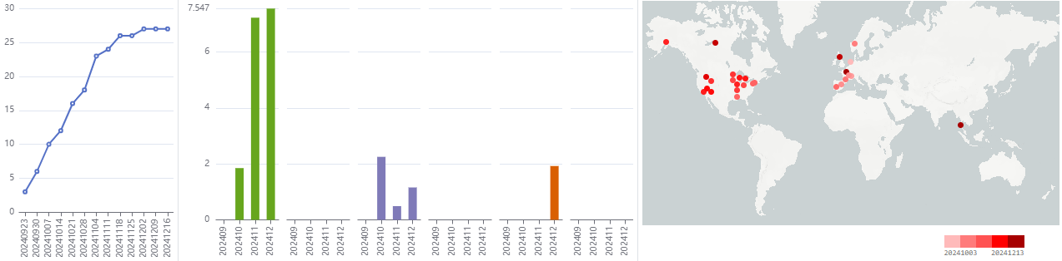
Emerging variant analysis 2025-01-07
EpiFlu™ Update
Influenza Emerging Variants by Spread
Subtype/Clade
Count^
Cumulative
locations
North
America
South
America
geoMap
Differentiating Mutations*
Europe
Africa
Asia
Oceania
H3N2/3C.2a1b.2a.2a.3a.1
155
+HA_T151K
% prevalence
^Count in past 100 days from analysis date
*All amino acid changes were tracked for HA sequences collected in the last 100 days. Next, only amino acid changes that have gained >=4 new locations in the last 50 days were selected to be part of a variant mutation signature (constellation). Each row represents a unique emerging variant mutation signature. Differentiating mutations refer to the amino acid changes in the emerging variant that set it apart from all other emerging variants in the first 50 days.

Slide 10
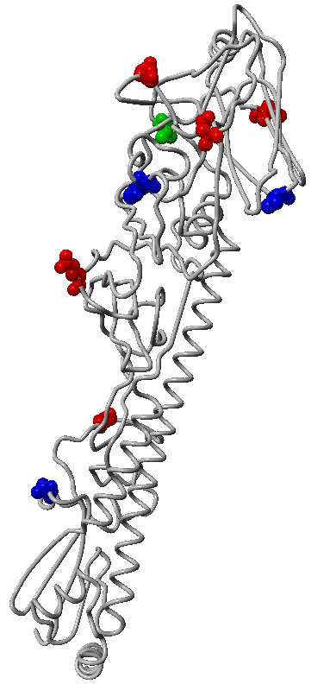
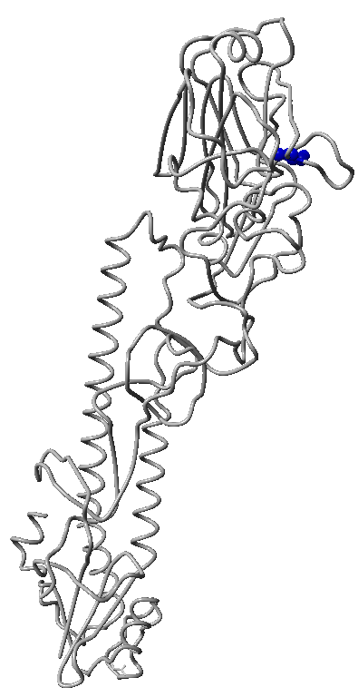
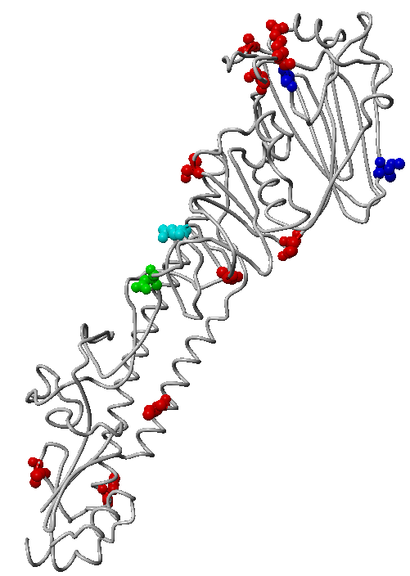
Influenza Hemagglutinin mutation surveillance 2025-01-09
EpiFlu™ Update
Changes in the Hemagglutinin for top emerging variants based on sequences collected in the past 100 days.
H1N1pdm
H3N2
B/Victoria
159R
233A
161N
154S
160G
239I
230T
143K
95L
138N
100S
183V
81K
255S
300Q
292K
52N
277E
294A
41V
389V
363M
468H
477T
Numbering relative to start codon in A/California/07/2009
Numbering relative to start codon in A/Hong Kong/4801/2014
Numbering relative to start codon in B/Brisbane/60/2008
3D model of A/Victoria/4897/2022 (H1N1pdm)-like virus using PDBID 7KNA A/Michigan/45/2015 as template. Mutations are coloured by emerging variants.
3D model of A/Croatia/10136RV/2023 (H3N2)-like virus using PDBID 4WE8 A/Victoria/361/2011 as template. Mutations are coloured by emerging variants.
3D structure of (B/Victoria lineage)-like virus using 4FQM B/Brisbane/60/2008. Mutations are coloured by emerging variants.

Slide 11
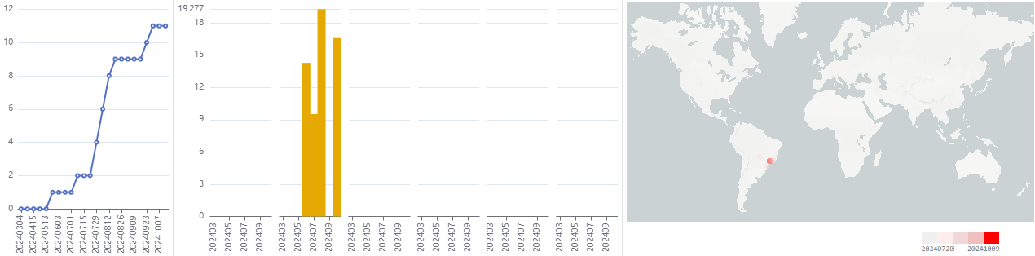
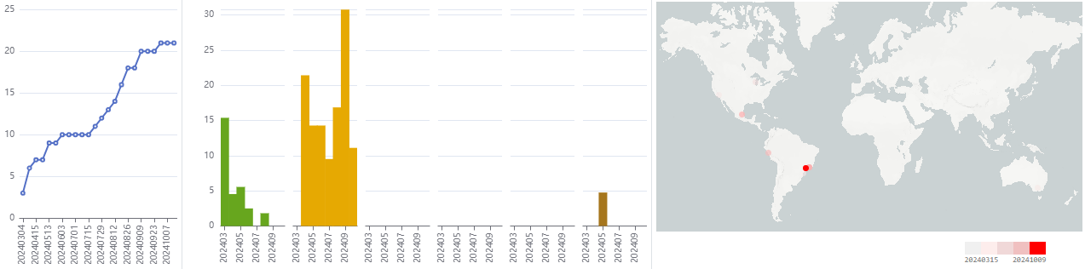
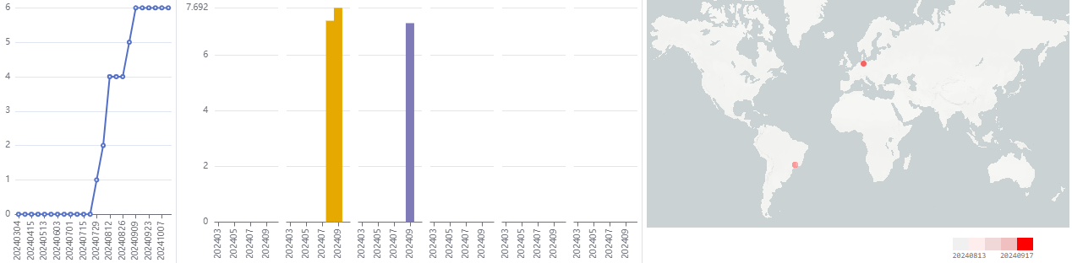
Emerging variant analysis 2025-01-07
EpiPox™ Update
Pox Emerging Variants by Spread
Subtype
Count^
Cumulative
locations
North
America
South
America
geoMap
Constellation*
Europe
Africa
Asia
Oceania
IIb (E.3)
24
A38R_S7L, A47R_S52L, A50R_D59N, A8L_M580I, B11R_S179L, E11L_P615S, E12L_L16F, E6R_S478L, G10R_S80L, I8R_E375K, N3R_R84K, P2L_M1I, Q1L_L56F, R1R_S90L
% prevalence
IIb (F.2)
46
B4R_E12K
% prevalence
IIb (E.3)
9
A38R_S7L, A47R_S52L, A50R_D59N, A8L_M580I, B11R_S179L, B9R_A218T, E11L_P615S, E12L_L16F, E6R_S478L, G10R_S80L, N3R_R84K, P2L_M1I, Q1L_L56F, R1R_S90L
% prevalence
*All amino acid changes were tracked for all sequences collected in the last 300 days. Next, only amino acid changes that have gained >=4 new locations in the last 200 days were selected to be part of a variant mutation signature (constellation). Each row represents a unique emerging variant mutation signature. The variant mutation signatures shown above have gained >=1 new location for clade Ib and >=4 new locations in the last 200 days for all other clades.

Slide 12
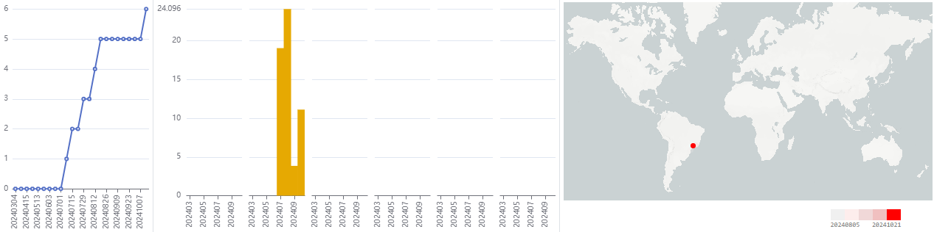
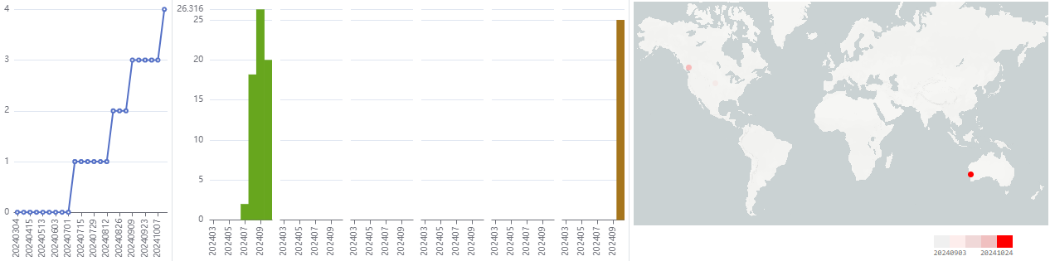
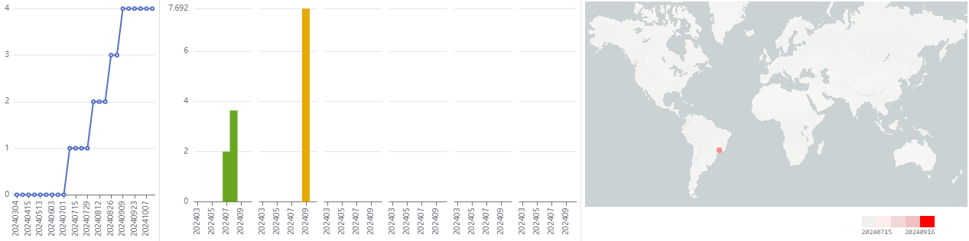
Emerging variant analysis 2025-01-07
EpiPox™ Update
Pox Emerging Variants by Spread
Subtype
Count^
Cumulative
locations
North
America
South
America
geoMap
Constellation*
Europe
Africa
Asia
Oceania
IIb (F.2)
27
A51R_D191N, B4R_E12K, I8R_A82T
% prevalence
IIb (F.1)
25
A38R_S167F, A46R_Q98stop, B10R_R170Q, D11L_R108C, E5R_S297L
% prevalence
IIb (F.4)
5
A22R_G312S, A46R_S29L, B17R_D330N, B20R_S30L, E1R_H218Y, E9R_E172K, O1L_S347F
% prevalence
*All amino acid changes were tracked for all sequences collected in the last 300 days. Next, only amino acid changes that have gained >=4 new locations in the last 200 days were selected to be part of a variant mutation signature (constellation). Each row represents a unique emerging variant mutation signature. The variant mutation signatures shown above have gained >=1 new location for clade Ib and >=4 new locations in the last 200 days for all other clades.

Slide 13
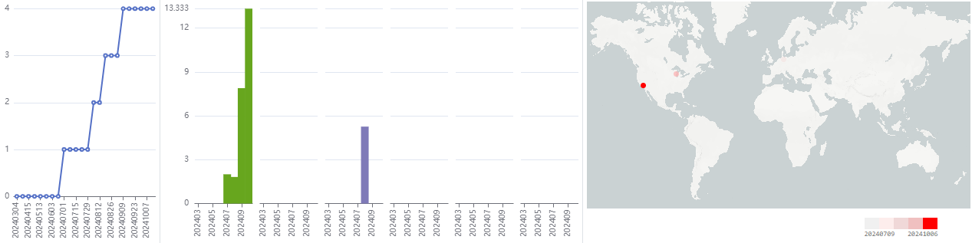
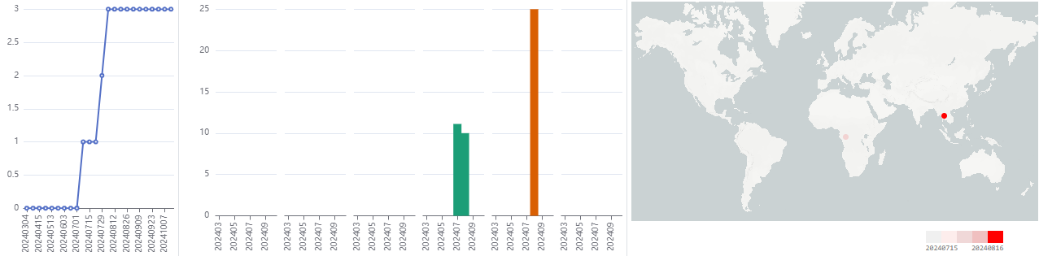
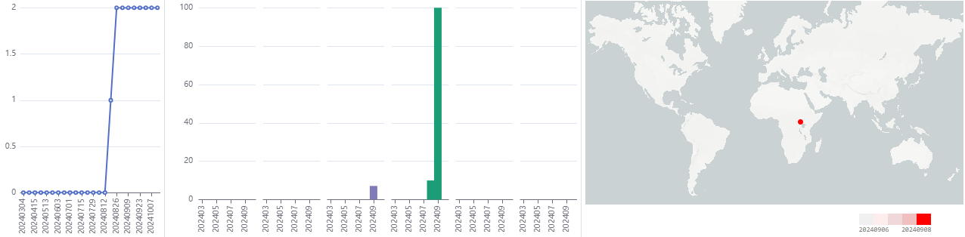
Emerging variant analysis 2025-01-07
EpiPox™ Update
Pox Emerging Variants by Spread
Subtype
Count^
Cumulative
locations
North
America
South
America
geoMap
Constellation*
Europe
Africa
Asia
Oceania
IIb (F.6)
8
A27L_S485L, A41L_S30F, B12R_E172K, B2R_S231F, B5R_E190del, B5R_S191del, D18L_G80E, E11L_R471C, F3L_R28C, Q1L_L112F
% prevalence
Ib
3
A24R_D32N, B10.5R_S18T, B4R_S227F, E8L_S124L
% prevalence
Ib
3
A24R_D32N, A28L_ins376II, B10.5R_S18T, B4R_S227F, E8L_S124L
% prevalence
*All amino acid changes were tracked for all sequences collected in the last 300 days. Next, only amino acid changes that have gained >=4 new locations in the last 200 days were selected to be part of a variant mutation signature (constellation). Each row represents a unique emerging variant mutation signature. The variant mutation signatures shown above have gained >=1 new location for clade Ib and >=4 new locations in the last 200 days for all other clades.

Slide 14
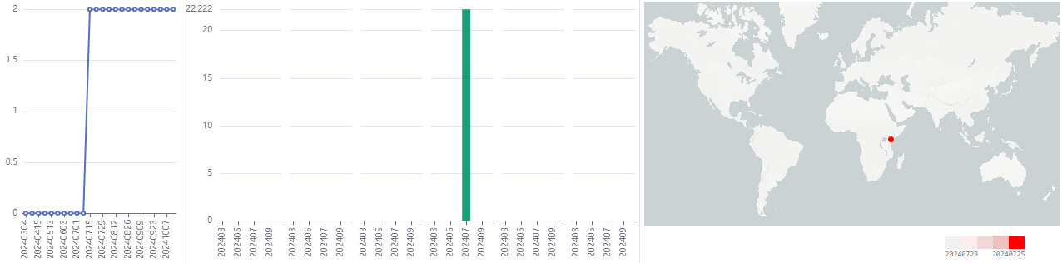
Emerging variant analysis 2025-01-07
EpiPox™ Update
Pox Emerging Variants by Spread
Subtype
Count^
Cumulative
locations
North
America
South
America
geoMap
Constellation*
Europe
Africa
Asia
Oceania
Ib
2
A24R_D32N, A32L_Q60del, B4R_S227F, E8L_S124L
% prevalence
*All amino acid changes were tracked for all sequences collected in the last 300 days. Next, only amino acid changes that have gained >=4 new locations in the last 200 days were selected to be part of a variant mutation signature (constellation). Each row represents a unique emerging variant mutation signature. The variant mutation signatures shown above have gained >=1 new location for clade Ib and >=4 new locations in the last 200 days for all other clades.

Slide 15
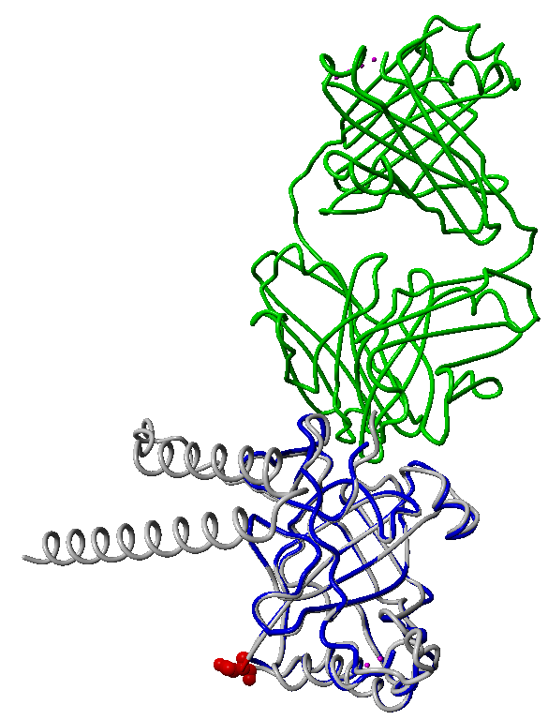
Mpox surface protein(s) mutation surveillance 2025-01-09
Changes in the E8L protein (envelope protein in the outer membrane of IMV) for top emerging variants based on sequences collected in the past 300 days.
Mpox E8L
124L
Homology model of Mpox E8L (gray ribbon) created using AlphaFold3 (confidence score pTM=0.77) using Uniprot ID: Q8V4Y0 as starting sequence. Structure is aligned to D8 protein (blue ribbon) of VACV PDB ID 5USH where it is bound to antibody Fab vv66 (green ribbon).

Slide 16
Mpox surface protein analysis
By Lee RTC, Lim YH, Nguyen M, Maurer-Stroh S
Method:
  Literature review of Mpox surface proteins, their functions and role as putative antigens
  Sequence alignment to determine amino acid differences in comparison of MVA vaccine vs Mpox clade Ib, MVA vs Mpox clade IIb and Mpox clade Ib vs IIb
  AlphaFold3 3D structure models of relevant surface proteins
  Mapping of amino acid differences onto the structure models
  Coloring of known epitopes from IEDB in the structure models (where available)
Findings:
Sequence and structure model comparison of 17 poxvirus surface antigen proteins show that the clade Ib virus did not gain significant new differences from the vaccine strain when compared to clade IIb where earlier data showed ~85% vaccine efficacy.

Slide 17
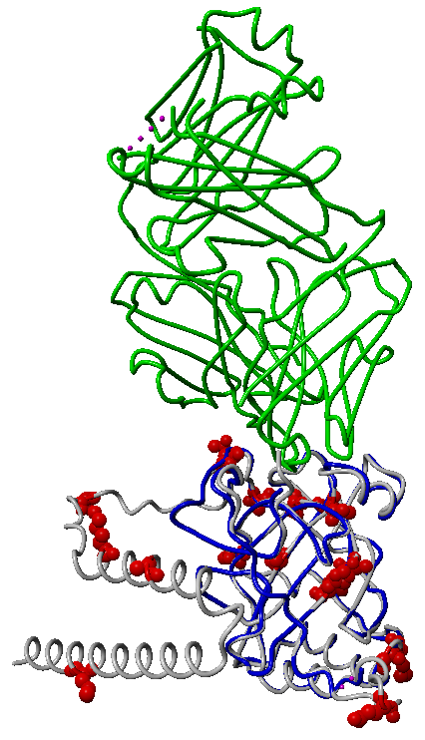
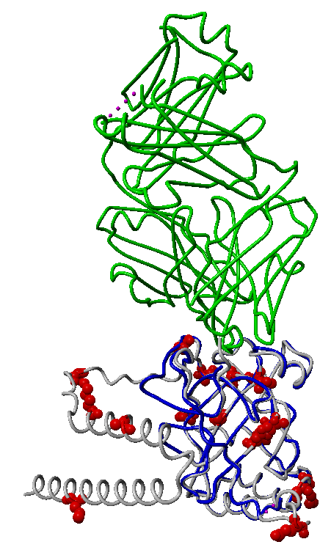
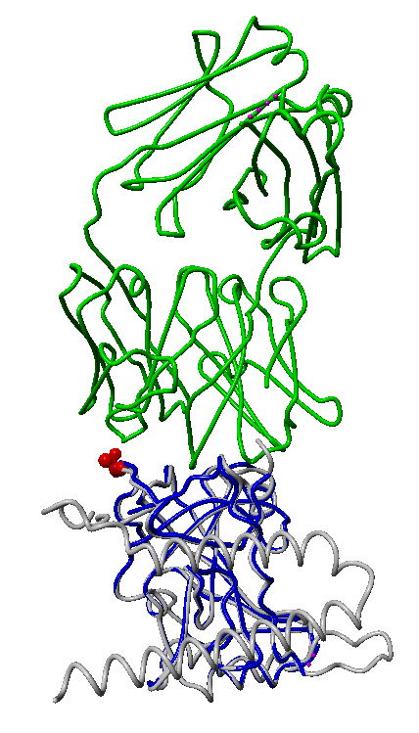
Mutational Differences in Surface Proteins between MVA VACV, clade Ib and clade IIb Mpox viruses
Mpox Surface Protein: E8L (https://doi.org/10.3389/fcimb.2024.1414224)
MVA vs Ib
MVA vs IIb
Ib vs IIb
19T
Homology model of Mpox E8L (gray ribbon) created using AlphaFold3 (confidence score pTM=0.77) using Uniprot ID: Q8V4Y0 as starting sequence. Structure is aligned to D8 protein (blue ribbon) of VACV PDB ID 5USH where it is bound to antibody Fab vv66 (green ribbon).

Slide 18
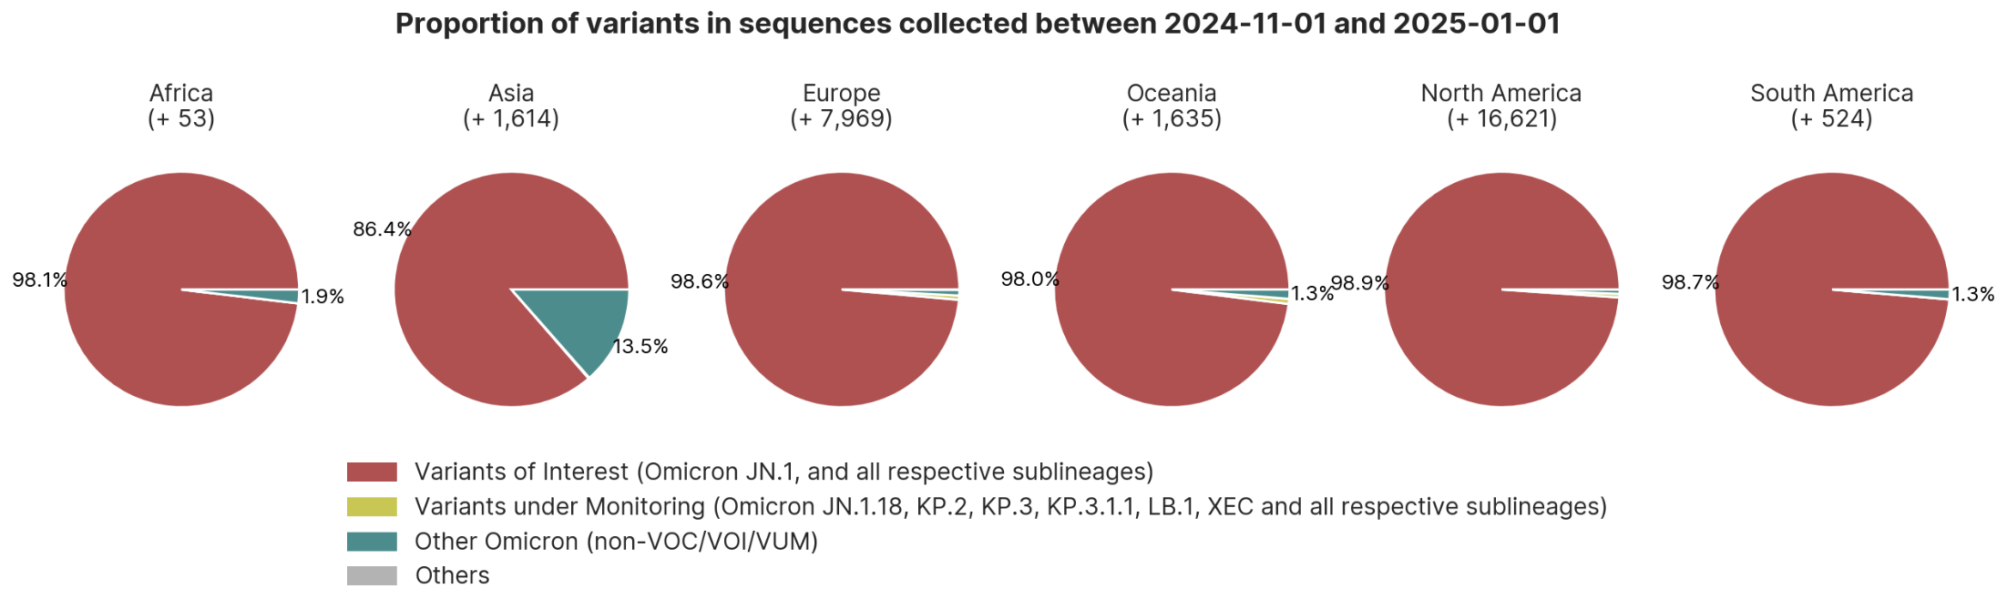
Regional distribution of subtypes in new coronavirus sequences
collected from 2024-11-01 to 2024-01-01
EpiCoV™ Update

Slide 19
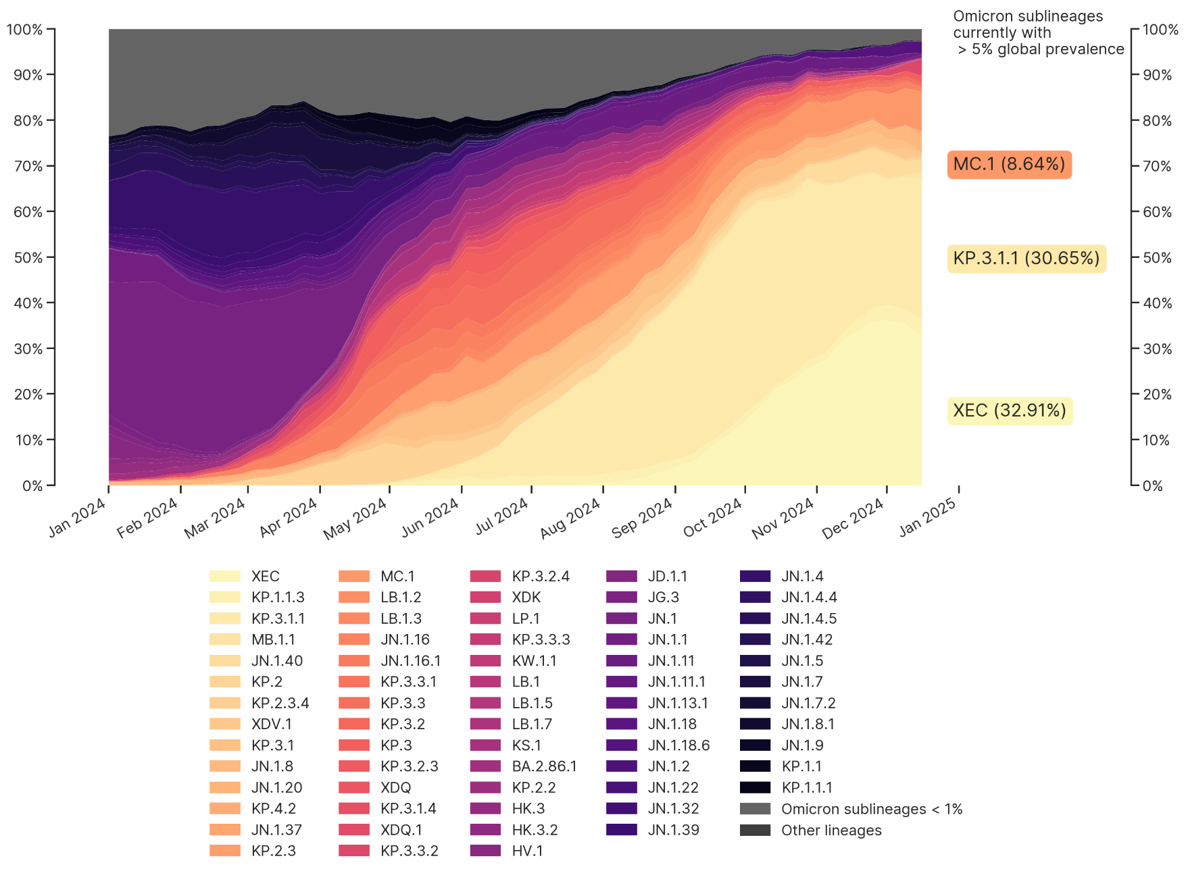
Timecourse of Omicron variant sublineage distribution
2025-01-09
EpiCoV™ Update
See https://www.who.int/en/activities/tracking-SARS-CoV-2-variants/ for variant information and definitions.

Slide 20
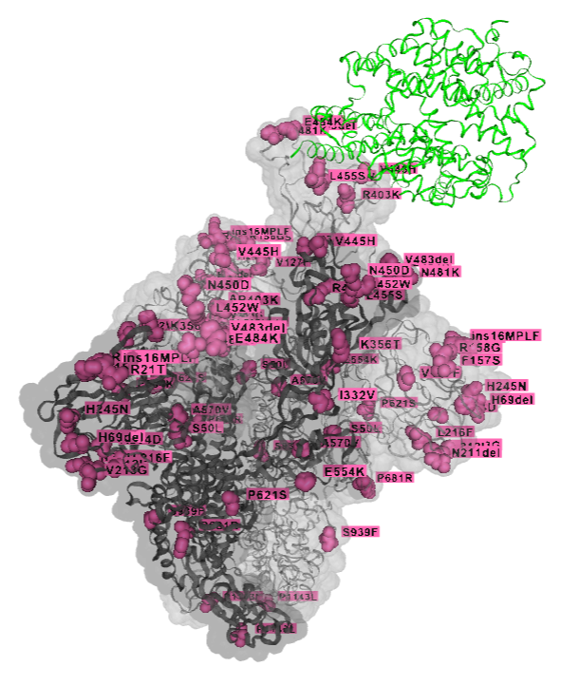
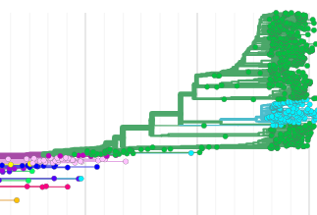

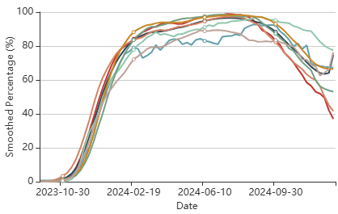
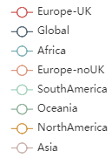
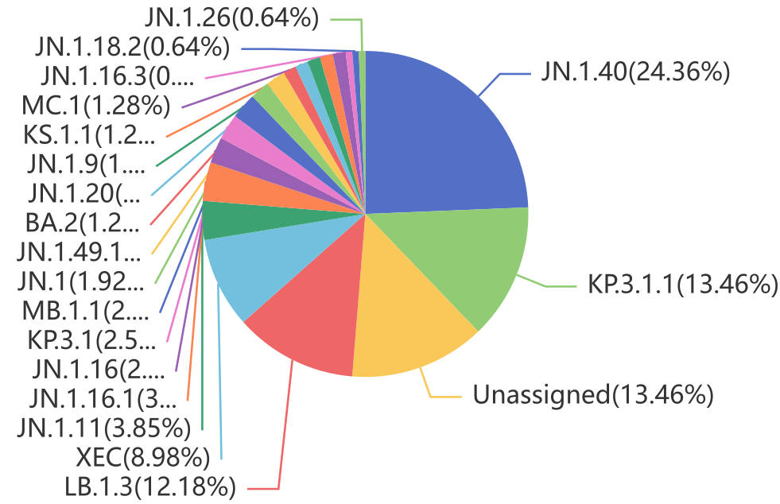
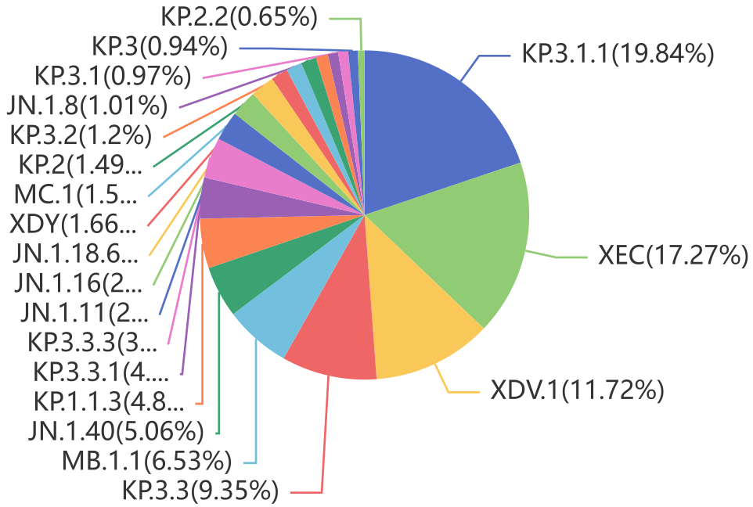
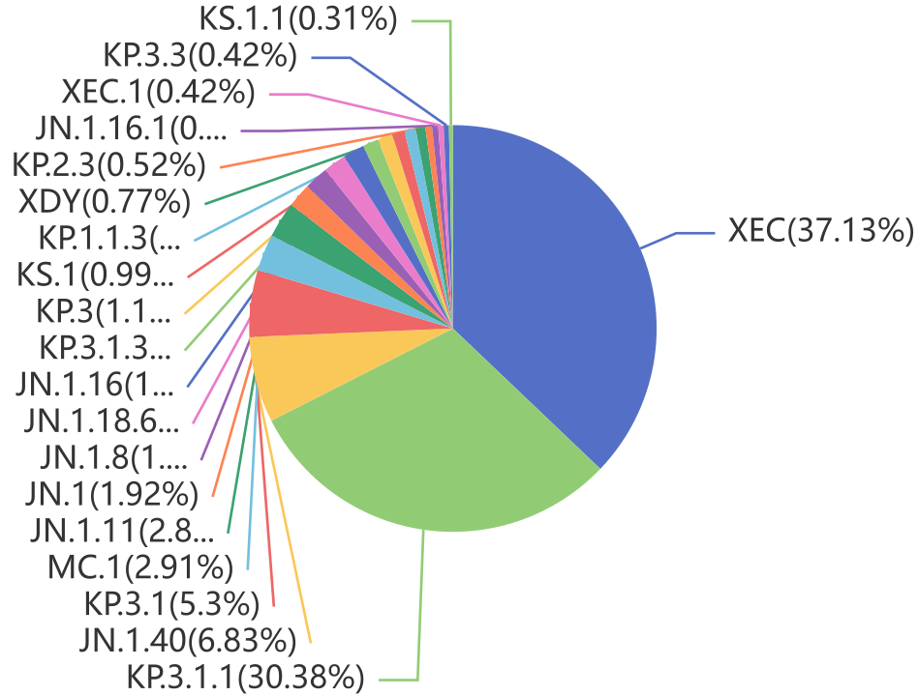



Emerging variant analysis 2025-01-09
EpiCoV™ Update
JN.1 sub-lineages continue to rise. As of 9 January 2025, 149 countries shared 509,471 JN.1+JN.1.* sequences. The phylogenetic relationship of the currently largest circulating sublineages is shown in the tree below and the VOI is also tracked at: https://gisaid.org/hcov19-variants/.
VOI JN.1* versus XBB1.5 vaccine strain spike substitutions
ACE2
KP.3*
MC.1
JN.1+JN.1*
XEC
JN.1.40
EG.5*
XBB.1.16*, XBB.1.9*
XBB.1.5*
XBB.2.3*
XBB.1.5*
family
2023-Dec
2024-Jun
2024-Dec
SARS-CoV-2 spike glycoprotein trimer (3 units shown, gray ribbons) in complex with human host cell receptor ACE2 (1 unit shown).
Recently approved updated vaccines use XBB.1.5 strains as basis. The majority of current strains in circulation globally belong to
the JN.1* family.
Africa
Asia
Europe
North America
Oceania
South America
Lineage distribution 8 Oct 2024 – 6 Jan 2025 (by collection date)

Slide 21


Representative phylogenetics
of recent genome sequences from 30 regions across China
(in global context)
2025-01-09
EpiCoV™ Update
We gratefully acknowledge the Authors from Originating and Submitting laboratories of sequence data on which the analysis is based.
Updated 2025-01-09
by FIOCRUZ, Brazil

Slide 22


Emerging variant analysis 2025-01-07
EpiCoV™ Update
Emerging Variants by Spread
Clade/Lineage
Count^
Cumulative
locations
North
America
South
America
geoMap
Constellation*
Europe
Africa
Asia
Oceania
GRA/KP.1.1.3
514
N_P13L, N_Q229K, Spike_A570V, Spike_D405N, Spike_D614G, Spike_D796Y, Spike_E484K, Spike_F456L, Spike_F486P, Spike_G142D, Spike_G339H, Spike_G446S, Spike_H245N, Spike_H655Y, Spike_H69del, Spike_I332V, Spike_K356T, Spike_K417N, Spike_L452W, Spike_L455S, Spike_N440K, Spike_N450D, Spike_N460K, Spike_N481K, Spike_N501Y, Spike_P681R, Spike_Q493E, Spike_Q498R, Spike_R158G, Spike_R346T, Spike_R403K, Spike_R408S, Spike_S371F, Spike_S373P, Spike_S375F, Spike_S477N, Spike_S939F, Spike_T376A, Spike_T478K, Spike_V445R, Spike_V483del, Spike_V70del, Spike_Y144del, Spike_Y505H
% prevalence
GRA (KP.3.1.1)
27
N_P13L, N_Q229K, N_T362I, Spike_A570V, Spike_D405N, Spike_D614G, Spike_D796Y, Spike_E484K, Spike_F456L, Spike_F486P, Spike_G142D, Spike_G339H, Spike_G446S, Spike_H245N, Spike_H655Y, Spike_H69del, Spike_I332V, Spike_K356T, Spike_K417N, Spike_L452W, Spike_L455S, Spike_N440K, Spike_N450D, Spike_N460K, Spike_N481K, Spike_N501Y, Spike_P681R, Spike_Q493E, Spike_Q498R, Spike_R158G, Spike_R403K, Spike_R408S, Spike_S371F, Spike_S373P, Spike_S375F, Spike_S477N, Spike_S939F, Spike_T376A, Spike_T478K, Spike_V445H, Spike_V483del, Spike_V70del, Spike_Y144del, Spike_Y505H
% prevalence
^Count in past 100 days from analysis date
*Constellation of aa changes shown in literature to have phenotypic effects such as antibody escape, ACE2 binding, changes in Spike protein expression and stability, as curated by CoVsurver. Constellations in Emerging Variants by Spread are ranked by gainInNumNewLocationsInPast30days x sumOfWeightedaaChanges. AA change in the constellation that differs from other common changes seen in the lineage are highlighted in orange.

Slide 23


Emerging variant analysis 2025-01-07
EpiCoV™ Update
Emerging Variants by Spread
Clade/Lineage
Count^
Cumulative
locations
North
America
South
America
geoMap
Constellation*
Europe
Africa
Asia
Oceania
GRA/KP.3.1.1
35
N_P13L, N_Q229K, Spike_A570V, Spike_D405N, Spike_D614G, Spike_D796Y, Spike_E484K, Spike_F456L, Spike_F486P, Spike_G142D, Spike_G339H, Spike_G446S, Spike_H245N, Spike_H655Y, Spike_H69del, Spike_I332V, Spike_K356T, Spike_K417N, Spike_L452W, Spike_L455S, Spike_N148T, Spike_N440K, Spike_N450D, Spike_N460K, Spike_N481K, Spike_N501Y, Spike_P681R, Spike_Q493E, Spike_Q498R, Spike_R158G, Spike_R403K, Spike_R408S, Spike_S371F, Spike_S373P, Spike_S375F, Spike_S477N, Spike_S939F, Spike_T376A, Spike_T478K, Spike_V445H, Spike_V483del, Spike_V70del, Spike_Y144del, Spike_Y505H
% prevalence
GRA (KP.3.1.1)
36
N_P13L, N_Q229K, Spike_A570V, Spike_D405N, Spike_D614G, Spike_D796Y, Spike_E484K, Spike_F456L, Spike_F486P, Spike_G142D, Spike_G339H, Spike_G446S, Spike_H245N, Spike_H655Y, Spike_H69del, Spike_I332V, Spike_K356T, Spike_K417N, Spike_L452W, Spike_L455S, Spike_N440K, Spike_N450D, Spike_N460K, Spike_N481K, Spike_N501Y, Spike_P681R, Spike_Q493E, Spike_Q498R, Spike_R158G, Spike_R346K, Spike_R403K, Spike_R408S, Spike_S371F, Spike_S373P, Spike_S375F, Spike_S477N, Spike_S939F, Spike_T376A, Spike_T478K, Spike_V445H, Spike_V483del, Spike_V70del, Spike_Y144del, Spike_Y505H
% prevalence
^Count in past 100 days from analysis date
*Constellation of aa changes shown in literature to have phenotypic effects such as antibody escape, ACE2 binding, changes in Spike protein expression and stability, as curated by CoVsurver. Constellations in Emerging Variants by Spread are ranked by gainInNumNewLocationsInPast30days x sumOfWeightedaaChanges. AA change in the constellation that differs from other common changes seen in the lineage are highlighted in orange.

Slide 24


Emerging variant analysis 2025-01-07
EpiCoV™ Update
Emerging Variants by Spread
Clade/Lineage
Count^
Cumulative
locations
North
America
South
America
geoMap
Constellation*
Europe
Africa
Asia
Oceania
GRA/JN.1.40
126
N_P13L, N_Q229K, Spike_A475V, Spike_A570V, Spike_D405N, Spike_D614G, Spike_D796Y, Spike_E484K, Spike_F456L, Spike_F486P, Spike_G142D, Spike_G339H, Spike_G446S, Spike_H245N, Spike_H655Y, Spike_H69del, Spike_I332V, Spike_K356T, Spike_K417N, Spike_K444R, Spike_L452W, Spike_L455S, Spike_N440K, Spike_N450D, Spike_N460K, Spike_N481K, Spike_N501Y, Spike_P681R, Spike_Q498R, Spike_R158G, Spike_R346T, Spike_R403K, Spike_R408S, Spike_S371F, Spike_S373P, Spike_S375F, Spike_S477N, Spike_S939F, Spike_T376A, Spike_T478K, Spike_V445H, Spike_V483del, Spike_V70del, Spike_Y144del, Spike_Y505H
% prevalence
GRA (KP.3.1.1)
26
N_P13L, N_Q229K, Spike_A570V, Spike_D405N, Spike_D614G, Spike_D796Y, Spike_E484K, Spike_F456L, Spike_F486P, Spike_G142D, Spike_G339H, Spike_G446S, Spike_H245N, Spike_H655Y, Spike_H69del, Spike_I332V, Spike_K356T, Spike_K417N, Spike_L452W, Spike_L455S, Spike_N440K, Spike_N450D, Spike_N460K, Spike_N481K, Spike_N501Y, Spike_P681R, Spike_Q493E, Spike_Q498R, Spike_R158G, Spike_R403K, Spike_R408S, Spike_S255F, Spike_S371F, Spike_S373P, Spike_S375F, Spike_S477N, Spike_S939F, Spike_T376A, Spike_T478K, Spike_V445H, Spike_V483del, Spike_V70del, Spike_Y144del, Spike_Y505H
% prevalence
^Count in past 100 days from analysis date
*Constellation of aa changes shown in literature to have phenotypic effects such as antibody escape, ACE2 binding, changes in Spike protein expression and stability, as curated by CoVsurver. Constellations in Emerging Variants by Spread are ranked by gainInNumNewLocationsInPast30days x sumOfWeightedaaChanges. AA change in the constellation that differs from other common changes seen in the lineage are highlighted in orange.

Slide 25


Emerging variant analysis 2025-01-07
EpiCoV™ Update
Emerging Variants by Spread
Clade/Lineage
Count^
Cumulative
locations
North
America
South
America
geoMap
Constellation*
Europe
Africa
Asia
Oceania
GRA/KP.3.1.1
27
N_P13L, N_P142S, N_Q229K, Spike_A570V, Spike_D405N, Spike_D614G, Spike_D796Y, Spike_E484K, Spike_F456L, Spike_F486P, Spike_G142D, Spike_G339H, Spike_G446S, Spike_H245N, Spike_H655Y, Spike_H69del, Spike_I332V, Spike_K356T, Spike_K417N, Spike_L452W, Spike_L455S, Spike_N440K, Spike_N450D, Spike_N460K, Spike_N481K, Spike_N501Y, Spike_P681R, Spike_Q493E, Spike_Q498R, Spike_R158G, Spike_R403K, Spike_R408S, Spike_S371F, Spike_S373P, Spike_S375F, Spike_S477N, Spike_S939F, Spike_T376A, Spike_T478K, Spike_V445H, Spike_V483del, Spike_V70del, Spike_Y144del, Spike_Y505H
% prevalence
GRA (KP.3.1.1)
26
N_P13L, N_Q229K, Spike_A570V, Spike_D405N, Spike_D614G, Spike_D796Y, Spike_E484K, Spike_F456L, Spike_F486P, Spike_G142D, Spike_G339H, Spike_G446S, Spike_H245N, Spike_H655Y, Spike_H69del, Spike_I332V, Spike_K356T, Spike_K417N, Spike_L452W, Spike_L455S, Spike_N440K, Spike_N450D, Spike_N460K, Spike_N481K, Spike_N501Y, Spike_P681R, Spike_Q493E, Spike_Q498R, Spike_R158G, Spike_R403K, Spike_R408S, Spike_R683Q, Spike_S371F, Spike_S373P, Spike_S375F, Spike_S477N, Spike_S939F, Spike_T376A, Spike_T478K, Spike_V445H, Spike_V483del, Spike_V70del, Spike_Y144del, Spike_Y505H
% prevalence
^Count in past 100 days from analysis date
*Constellation of aa changes shown in literature to have phenotypic effects such as antibody escape, ACE2 binding, changes in Spike protein expression and stability, as curated by CoVsurver. Constellations in Emerging Variants by Spread are ranked by gainInNumNewLocationsInPast30days x sumOfWeightedaaChanges. AA change in the constellation that differs from other common changes seen in the lineage are highlighted in orange.

Slide 26


Emerging variant analysis 2025-01-07
EpiCoV™ Update
Emerging Variants by Spread
Clade/Lineage
Count^
Cumulative
locations
North
America
South
America
geoMap
Constellation*
Europe
Africa
Asia
Oceania
GRA/KP.1.1.3
8
N_A134V, N_P13L, N_Q229K, Spike_A570V, Spike_D405N, Spike_D614G, Spike_D796Y, Spike_E484K, Spike_F456L, Spike_F486P, Spike_G142D, Spike_G339H, Spike_G446S, Spike_H245N, Spike_H655Y, Spike_H69del, Spike_I332V, Spike_K356T, Spike_K417N, Spike_L452W, Spike_L455S, Spike_N440K, Spike_N450D, Spike_N460K, Spike_N481K, Spike_N501Y, Spike_P681R, Spike_Q493E, Spike_Q498R, Spike_R158G, Spike_R346T, Spike_R403K, Spike_R408S, Spike_S371F, Spike_S373P, Spike_S375F, Spike_S477N, Spike_S939F, Spike_T376A, Spike_T478K, Spike_V445R, Spike_V483del, Spike_V70del, Spike_Y144del, Spike_Y505H
% prevalence
GRA (KP.1.1.3)
5
N_P13L, N_Q229K, Spike_A570V, Spike_D405N, Spike_D614G, Spike_D796Y, Spike_E484K, Spike_F456L, Spike_F486P, Spike_G142D, Spike_G339H, Spike_G446S, Spike_H245N, Spike_H655Y, Spike_H69del, Spike_I332V, Spike_K356T, Spike_K417N, Spike_L452W, Spike_L455S, Spike_N440K, Spike_N450D, Spike_N460K, Spike_N481K, Spike_N487D, Spike_N501Y, Spike_P681R, Spike_Q493E, Spike_Q498R, Spike_R158G, Spike_R346T, Spike_R403K, Spike_R408S, Spike_S371F, Spike_S373P, Spike_S375F, Spike_S477N, Spike_S939F, Spike_T376A, Spike_T478K, Spike_V445R, Spike_V483del, Spike_V70del, Spike_Y144del, Spike_Y505H
% prevalence
^Count in past 100 days from analysis date
*Constellation of aa changes shown in literature to have phenotypic effects such as antibody escape, ACE2 binding, changes in Spike protein expression and stability, as curated by CoVsurver. Constellations in Emerging Variants by Spread are ranked by gainInNumNewLocationsInPast30days x sumOfWeightedaaChanges. AA change in the constellation that differs from other common changes seen in the lineage are highlighted in orange.

Slide 27

Spike glycoprotein mutation surveillance 2025-01-09
EpiCoV™ Update
Changes in the spike glycoprotein for the top 4 spreading lineages based on 9,562 sequences collected in the past 60 days.
Full list at www.gisaid.org/spike
Numbering relative to start codon 21,563 in hCoV-19/Wuhan/WIV04/2019
● Spike glycoprotein variation found in ≤ 100 sequences
● Spike glycoprotein variation found in >100 sequences
● Spike glycoprotein variation found in ≥ 10% of sequences from the lineage
lineage defining mutations: amino acid changes found
in ≥ 10% of sequences in the lineage
● Spike glycoprotein variation near host receptor, or other functional annotation
● Insertion/deletion
● Spike glycoprotein variation altering potential N-glycosylation sites
lineage emerging mutations: amino acid changes found in <10% of sequences in the lineage that are also found in top 50 emerging constellations by Spread and top 20 emerging constellations by Acceleration (See emerging variant analysis for details)

Slide 28

Regional distribution of subtypes in new RSV sequences
collected from 2024-02-01 to 2025-01-01
EpiRSV™ Update

Slide 29



Emerging variant analysis 2025-01-07
EpiRSV™ Update
RSV Emerging Variants by Spread
Subtype
Count^
Cumulative
locations
North
America
South
America
geoMap
Constellation*
Europe
Africa
Asia
Oceania
B
597
F_S190N, F_S211N, F_S389P, G_A74V, G_I137T, G_I252T, G_I268T, G_K256N, G_P214S, G_P221L, G_S100G, G_S275P, G_T131A, G_Y285H
% prevalence
A
30
F_S276N, F_T12I, G_D284G, G_G224E, G_G98V, G_H258Q, G_H266L, G_H90Y, G_I134K, G_I265L, G_K262E, G_L101S, G_L97F, G_N178G, G_P230T, G_P298L, G_P71L, G_S243T, G_T113I, G_V131D, G_Y304H
% prevalence
B
161
F_F12I, F_S190N, F_S211N, F_S389P, G_A74V, G_I137T, G_I252T, G_I268T, G_P214S, G_P221L, G_S100G, G_S275P, G_T131A, G_Y285H
% prevalence
^Count in past 500 days from analysis date
*The analysis consists of sequences collected in the last 500 days. Next, only amino acid changes from F and G genes that have gained at least 7 new locations in the last 300 days were selected to be part of a variant mutation signature (constellation). Each row represents a unique emerging variant mutation signature.

Slide 30



Emerging variant analysis 2025-01-07
EpiRSV™ Update
RSV Emerging Variants by Spread
Subtype
Count^
Cumulative
locations
North
America
South
America
geoMap
Constellation*
Europe
Africa
Asia
Oceania
B
93
F_R42K, F_S190N, F_S211N, F_S389P, G_A74V, G_I137T, G_I252T, G_I268T, G_K256N, G_P214S, G_P221L, G_S100G, G_S265P, G_S275P, G_T131A, G_Y285H
% prevalence
A
196
F_V127I, G_D284G, G_G224V, G_H90Y, G_I134K, G_I265L, G_K262E, G_L101F, G_L142S, G_P71L, G_S243I, G_T319I, G_T320A, G_Y304H
% prevalence
B
57
F_S190N, F_S211N, F_S389P, G_A74V, G_H112Y, G_I137T, G_I252T, G_I268T, G_K256N, G_P214S, G_P221L, G_S100G, G_S275P, G_T131A, G_V249A, G_Y285H
% prevalence
^Count in past 500 days from analysis date
*The analysis consists of sequences collected in the last 500 days. Next, only amino acid changes from F and G genes that have gained at least 7 new locations in the last 300 days were selected to be part of a variant mutation signature (constellation). Each row represents a unique emerging variant mutation signature.

Slide 31



Emerging variant analysis 2025-01-07
EpiRSV™ Update
RSV Emerging Variants by Spread
Subtype
Count^
Cumulative
locations
North
America
South
America
geoMap
Constellation*
Europe
Africa
Asia
Oceania
A
18
F_A518V, F_L119H, G_D284G, G_E295V, G_G224E, G_H90Y, G_I134K, G_I265L, G_K262E, G_L101F, G_L142S, G_L314P, G_P276L, G_P71L, G_S243I, G_T320A, G_V225A, G_Y304H
% prevalence
A
25
F_A103T, F_T122V, G_A57V, G_D284G, G_G106E, G_G224E, G_H90Y, G_I134K, G_I265L, G_K209R, G_K262E, G_L101F, G_L248I, G_L310P, G_P206Q, G_P71L, G_S243I, G_T319I, G_T320A, G_V303A, G_Y304H
% prevalence
A
9
F_L20F, F_S276N, F_T12I, G_D284G, G_E263K, G_G224E, G_H258Q, G_H266L, G_H90Y, G_I134K, G_I265L, G_K262E, G_L101S, G_L314P, G_N178G, G_P230T, G_P298L, G_P71L, G_R151H, G_S243I, G_S250F, G_T113I, G_V131D, G_V225A, G_V303I
% prevalence
^Count in past 500 days from analysis date
*The analysis consists of sequences collected in the last 500 days. Next, only amino acid changes from F and G genes that have gained at least 7 new locations in the last 300 days were selected to be part of a variant mutation signature (constellation). Each row represents a unique emerging variant mutation signature.

Slide 32

Emerging variant analysis 2025-01-07
EpiRSV™ Update
RSV Emerging Variants by Spread
Subtype
Count^
Cumulative
locations
North
America
South
America
geoMap
Constellation*
Europe
Africa
Asia
Oceania
A
67
F_V127I, G_D284G, G_E295K, G_G224V, G_H90Y, G_I134K, G_I265L, G_K262E, G_L101F, G_L142S, G_P71L, G_S243I, G_T319I, G_T320A, G_Y304H
% prevalence
^Count in past 500 days from analysis date
*The analysis consists of sequences collected in the last 500 days. Next, only amino acid changes from F and G genes that have gained at least 7 new locations in the last 300 days were selected to be part of a variant mutation signature (constellation). Each row represents a unique emerging variant mutation signature.

Slide 33


RSV F protein mutation surveillance 2025-01-09
EpiRSV™ Update
Changes in the F protein for top emerging variants based on sequences collected in the past 500 days.
RSV A
RSV B
211N
190N
276N
42K
389P
PDB ID 8DZW A2 strain. Mutations are coloured by emerging variants.

